Slide 1

Fundamental Concepts of Data Security
Security Systems
Notes:
Note: This is expected to be delivered over three lectures/workshops

Slide 2
COMMONWEALTH OF AUSTRALIA
Copyright Regulation 1969
WARNING
This material has been copied and communicated to you by
or on behalf of Curtin University of Technology pursuant
to Part VB of the Copyright Act 1968 (the Act)
The material in this communication may be subject to
copyright under the Act. Any further copying or
communication of this material by you may be the
subject of copyright protection under the Act.
Do not remove this notice

Slide 3
Security Management
Putting in place an effective security system requires planning, resources and effort from all levels in an organization.
Support from the management of an organization is key for a good security system because it is the only entity that can effectively provide:
  List of assets and information to be protected
  The resources to setup and maintain the system: equipment, training, education
  The means to enable enforcement of policy compliance and revision
Notes:
Security management relies on properly identifying and valuing a company’s assets, and then implementing security policies, procedures, standards, and guidelines to provide integrity, confidentiality, and availability for those assets. Various management tools are used to classify data and perform risk analysis and assessments. These tools identify vulnerabilities and exposure rates and rank the severity of identified vulnerabilities so that effective countermeasures can be implemented to mitigate risk in a cost-effective manner. Management’s responsibility is to provide protection for the resources it is responsible for and the company overall. These resources come in human, capital, hardware, and informational forms. Management must concern itself with ensuring that a security program is set up that recognizes the threats that can affect these resources and be assured that the necessary protective measures are put into effect.
The necessary resources and funding need to be available, and strategic representatives must be ready to participate in the security program. Management must assign responsibility and identify the roles necessary to get the security program off the ground and to keep it thriving and evolving as the environment changes. Management must also integrate the program into the current business environment and monitor its accomplishments. Management’s support is one of the most important pieces of a security program. A simple nod and a wink will not provide the amount of support required.
The security program needs to:
Be driven by the management to have a better chance of being effective.
To be developed in terms of the whole of the organization and then refined to fit the specific areas within the organization.

Slide 4
Security Management Responsibilities
Help achieve business goals
Work with all internal and external stakeholders
Develop and implement security policies, procedures, standards, guidelines
Perform risk analysis, assessments, and security audits
Implement and monitor security programs
Ensure compliance
Notes:
Security Management Responsibilities
In the world of security, management’s functions involve determining objectives, scope, policies, priorities, and strategies. Management needs to define a clear scope and, before 100 people run off in different directions trying to secure the environment, to determine actual goals expected to be accomplished from a security program. Management also needs to evaluate business objectives, security risks, user productivity, and functionality requirements and objectives. Finally, management must define steps to ensure that all of these issues are accounted for and properly addressed.
Many companies look at the business and productivity elements of the equation only and figure that information and computer security fall within the IT administrator’s responsibilities. In these situations, management is not taking computer and information security seriously, the consequence of which is that security will most likely remain underdeveloped, unsupported, underfunded, and unsuccessful. Security needs to be addressed at the highest levels of management. The IT administrator can consult with management on the subject, but the security of a company should not be delegated entirely to the IT or security administrator.

Slide 5
Security Management Approaches
Top-down
  The initiation, support, and direction come from top management, work their way through middle management, and then reach staff members
  More aligned with the organization’s long-term strategic goals
  More likely to be effective due to support of management
  May not address short-term issues
Bottom-up
  Security program developed without getting proper management support and direction
  Ad-hoc, focus on short-term issues
  Not aligned with strategic goals, lack support from top management, difficult in large organisations, likely ineffective
Notes:
The Top-Down Approach to Security
When a house is built, the workers start with a blueprint of the structure, then pour the foundation, and then erect the frame. As the building of the house continues, the workers know what the end result is supposed to be, so they add the right materials, insert doors and windows as specified in the blueprints, erect support beams, provide sturdy ceilings and floors, and add the plaster and carpet and smaller details until the house is complete. Then inspectors come in to ensure that the structure of the house and the components used to make it are acceptable. If this process did not start with a blueprint and a realized goal, the house could end up with an unstable foundation and doors and windows that don’t shut properly. As a result, the house would not pass inspection—meaning much time and money would have been wasted.
Building a security program is analogous to building a house. When designing and implementing a security program, the security professionals must determine the functionality and realize the end result expected. Many times, companies just start locking down computers and installing firewalls without taking the time to understand the overall security requirements, goals, and assurance levels they expect from security as a whole within their environment. The team involved in the process should start from the top with very broad ideas and terms and work its way down to detailed configuration settings and system parameters. At each step, the team should keep in mind the overall security goals so each piece it adds will provide more granularity to the intended goal. This helps the team avoid splintering the main objectives by running in 15 different directions at once.
The next step is to develop and implement procedures, standards, and guidelines that support the security policy and to identify the security countermeasures and methods to be put into place. Once these items are developed, the security program increases in granularity by developing baselines and configurations for the chosen security controls and methods.
If security starts with a solid foundation and develops over time with understood goals and objectives, a company does not need to make drastic changes midstream. The process can be methodical, requiring less time, funds, and resources, and provide a proper balance between functionality and protection. This is not the norm, but with your insight, maybe you can help your company approach security in a more controlled manner. You could provide the necessary vision and understanding of how security should be properly planned and implemented, and how it should evolve in an organized manner, thereby helping the company avoid a result that is essentially a giant heap of disjointed, flawed security products.
A security program should use a top-down approach, meaning that the initiation, support, and direction come from top management, work their way through middle management, and then reach staff members. In contrast, a bottom-up approach refers to a situation in which the IT department tries to develop a security program without getting proper management support and direction. A bottom-up approach is usually less effective, not broad enough, and doomed to fail. A top-down approach makes sure the people actually responsible for protecting the company’s assets (senior management) are driving the program.

Slide 6
Administration and Supporting Controls
The security system requires:
  information ownership to be clearly specified
  clear definition of staff responsibilities
  policies to handle asset/information access
  clear hierarchy and reporting procedure
Notes:
Security Administration and Supporting Controls
If no security officer role currently exists, one should be established by management. The security officer role is directly responsible for monitoring a majority of the facets of a security program. Depending on the organization, security needs, and size of the environment, the security administration may consist of one person or a group of individuals who work in a central or decentralized manner. Whatever its size, the security administration requires a clear reporting structure, an understanding of responsibilities, and testing and monitoring capabilities to make sure compromises do not slip in because of a lack of communication or comprehension.
Information owners should dictate which users can access their resources and what those users can do with those resources after they access them. The security administration’s job is to make sure these objectives are implemented.
The information owner (also called the data owner) is usually a senior executive within the management group of the company, or the head of a specific department. The information owner has the corporate responsibility for data protection and would be the one held liable for any negligence when it comes to protecting the company’s information assets. The person who holds this role is responsible for assigning classifications to information and for dictating how the data should be protected. If the information owner does not lay out the foundation of data protection and ensure the directives are being enforced, she would be violating the due care concept.
By having a security administration group, a company ensures it does not lose focus on security and that it has a hierarchical structure of responsibility in place. The security officer’s job is to ensure that management’s security directives are fulfilled, not to construct those directives in the first place. There should be a clear communication path between the security administration group and senior management to make certain the security program receives the proper support and to ensure management makes the decisions. Too often, senior management is extremely disconnected from security issues, despite the fact that when a serious security breach takes place, senior management must explain the reasons to business partners, shareholders, and the public. After this humbling experience, the opposite problem tends to arise—senior management becomes too involved. A healthy relationship between the security administration group and senior management should be developed from the beginning, and communication should easily flow in both directions.
Inadequate management can undermine the entire security effort in a company. Among the possible reasons for inadequate management are that management does not fully understand the necessity of security; security is in competition with other management goals; management views security as expensive and unnecessary; or management applies lip service instead of real support to security. Powerful and useful technologies, devices, software packages, procedures, and methodologies are available to provide the exact level of security required, but without proper security management and management support, none of this really matters.

Slide 7
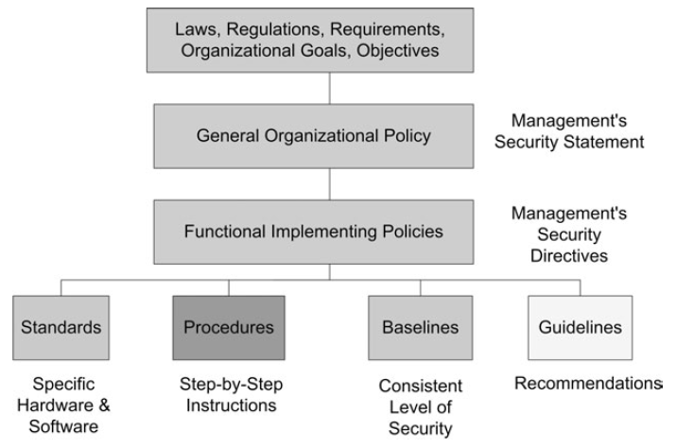
Security Management Concepts
Policies
Standards
Procedures
Baselines
Guidelines
Source: Fig. 1.2 OFFICIAL (ISC)2® GUIDE TO THE CISSP® CBK®, 2007
Notes:
Imagine the day-to-day operation of an organization without any policies. Individuals would have to make decisions about what is right or wrong for the company based upon their personal values or their own past experience. This could potentially consist of as many values as there are people in the organization. Management would also be failing to demonstrate due diligence by not putting practices in place to protect the investors and manage the employees of the organization. Policies establish the glue that ensures everyone has a common set of expectations and communicates management’s goals and objectives.
Procedures, standards, guidelines, and baselines are different components that support the implementation of the security policy. A policy without mechanisms for its implementation is analogous to an organization having a business strategy without action plans to execute the strategy. In this situation, there would be limited chance of success, as expectations to achieve the higher-level business strategy would not be clear to the workforce. Similarly, policies communicate management’s expectations, which are fulfilled through the execution of procedures and adherence to standards, baselines, and guidelines.
Security policies may consist of different types, depending upon the specific need for the policy.
Organizational or program policy: This policy is issued by a senior management individual, who creates the authority and scope for the security program. The purpose of the program is described, and the assigned responsibility is defined for carrying out the information security mission. The goals of confidentiality, integrity, and availability are addressed in the policy.
Functional, issue-specific policies: While the organizational security policies are broad in scope, the functional or issue-specific policies address areas of particular security concern requiring clarification.
System-specific policies: Areas where it is desired to have clearer direction or greater control for a specific technical or operational area may have more detailed policies.
The more detailed and issue specific the written policy is, the higher the likelihood is that the policy will require more frequent changes.
Standards.
Whereas policies define what an organization needs, standards take this a step further and define the requirements. Standards provide the agreements that provide interoperability within the organization through the use of common protocols. Standards simplify the operation of the security controls within the company and increase efficiency.
Procedures.
Procedures are step-by-step instructions in support of the policies, standards, guidelines, and baselines. The procedure indicates how the policy will be implemented and who does what to accomplish the tasks. The procedure provides clarity and a common understanding to the operation required to effectively support the policy on a consistent basis.
Baselines.
Baselines provide descriptions of how to implement security packages to ensure that these implementations are consistent throughout the organization. Different software packages, hardware platforms, and networks have different methods of ensuring security. There are many different options and settings that must be determined to provide the desired protection. An analysis of the available configuration settings and subsequent settings desired, forms the basis for future, consistent implementation of the standard.
Guidelines.
Guidelines are discretionary or optional controls used to enable individuals to make judgments with respect to security actions. A good exercise is to replace the word guideline with the word optional. Guidelines are also those recommendations, best practices, and templates provided by other organizations such as the Control Objectives for Information and related Technology (COBIT), the Capability Maturity Model (CMM), ISO 17799, and British Standard 7799, security configuration recommendations such as those from the National Institute of Standards and Technology (NIST) or the National Security Agency (NSA), organizational guidelines, or other governmental guidelines.

Slide 8
Basic Security Concepts
Vulnerability: weakness in any component of an info system
Threat: a possible scenario that some threat agent exploits a vulnerability and causes damage to a system
Risk: measure of the likelihood and impact of a threat
Countermeasure: safeguard to prevent or mitigate risk
Incident: some damage has occurred
Notes:
SECURITY DEFINITIONS
The words “vulnerability,” “threat,” “risk,” and “exposure” often are used to represent the same thing, even though they have different meanings and relationships to each other. It is important to understand each word’s definition, but it is more important to understand each concept’s relationship to the other concepts.
A vulnerability is a software, hardware, procedural, or human weakness that may provide an attacker the open door he is looking for to enter a computer or network and have unauthorized access to resources within the environment. A vulnerability characterizes the absence or weakness of a safeguard that could be exploited. This vulnerability may be a service running on a server, unpatched applications or operating system software, unrestricted modem dial-in access, an open port on a firewall, lax physical security that allows anyone to enter a server room, or unenforced password management on servers and workstations.
A threat is any potential danger to information or systems. The threat is that someone, or something, will identify a specific vulnerability and use it against the company or individual. The entity that takes advantage of a vulnerability is referred to as a threat agent. A threat agent could be an intruder accessing the network through a port on the firewall, a process accessing data in a way that violates the security policy, a tornado wiping out a facility, or an employee making an unintentional mistake that could ex- pose confidential information or destroy a file’s integrity.
A risk is the likelihood of a threat agent taking advantage of a vulnerability and the corresponding business impact. If a firewall has several ports open, there is a higher likelihood that an intruder will use one to access the network in an unauthorized method. If users are not educated on processes and procedures, there is a higher likelihood that an employee will make an intentional or unintentional mistake that may destroy data. If an intrusion detection system (IDS) is not implemented on a network, there is a higher likelihood an attack will go unnoticed until it is too late. Risk ties the vulnerability, threat, and likelihood of exploitation to the resulting business impact.
An exposure (incident) is an instance of being exposed to losses from a threat agent. A vulnerability exposes an organization to possible damages. If password management is lax and password rules are not enforced, the company is exposed to the possibility of having users’ passwords captured and used in an unauthorized manner. If a company does not have its wiring inspected and does not put proactive fire prevention steps into place, it exposes itself to potentially devastating fires.
A countermeasure (safeguard), is put into place to mitigate the potential risk. A countermeasure may be a software configuration, a hardware device, or a procedure that eliminates a vulnerability or that reduces the likelihood a threat agent will be able to exploit a vulnerability. Examples of countermeasures include strong password management, a security guard, access control mechanisms within an operating system, the implementation of basic input/output system (BIOS) passwords, and security-awareness training.
If a company has antivirus software but does not keep the virus signatures up-to- date, this is a vulnerability. The company is vulnerable to virus attacks. The threat is that a virus will show up in the environment and disrupt productivity. The likelihood of a virus showing up in the environment and causing damage is the risk. If a virus infiltrates the company’s environment, then a vulnerability has been exploited and the company is exposed to loss. The countermeasures in this situation are to update the signatures and install the antivirus software on all computers.
Applying the right countermeasure can eliminate the vulnerability and exposure, and thus reduce the risk. The company cannot eliminate the threat agent, but it can protect itself and prevent this threat agent from exploiting
vulnerabilities within the environment.
Example: SQL injection
Vulnerability: a database server software does not correctly parse special characters in SQL requests
Threat: a hacker may exploit the above database server software’s vulnerability by issuing specially crafted requests to steal confidential information
Risk: high rating of the likelihood and impact of the above threat event
Incident: an SQL injection attack has happened and hacker managed to steal all users’ information from a vulnerable database system
Countermeasure: patching of database serversoftware to prevent SQL injection attacks

Slide 9
Basic Security Concepts
Subject: users/system/applications requiring access to either information, services or assets
Object: resources in terms of information, services or assets to which the subjects would like to have access to
Trust: provides a measure of reliability and truthfulness - access and privileges are assigned based on the level of "trust" associated with a subject
Notes:
Subjects and Objects
The first basic concept focuses on things to be protected and the entities who want access to those things. The things are what are formally called objects and the entities are formally called subjects. Objects (which are generally organizational assets) can be, for example, computers, terminals, applications, databases, user agents, buildings, rooms, communications equipment, power facilities, documentation, or I/O devices (printers, terminals, etc.). Subjects (also commonly referred to as “principals,” “actors,” or “users”) can be, for example, any networked elements (computers, routers, servers, workstations), application servers and clients, DBMSs, user agents, or human beings.
Because computers can interact, let alone programs executing within these computers, there are times when they have to be viewed as subjects. However, this is an abstraction that should only serve as a basic model. A subject in one context may be viewed as an object in a different context, for example, a computer program can be considered a subject when it interacts with stored information (data), yet the same program can be considered an object when a human uses the program or the program is being manipulated by another software component (e.g., by a compiler or a program virus). The critical point here is to be specific as to what subjects are being considered.
What is the definition of trust in the context of security in a computing environment?
The word “trust” is used quite frequently in everyday speech and even used during information security conversations. However, to be used in an engineering context, we need a clear definition of trust. Two typical definitions are:
Confidence in the integrity, ability, character, and truth of a person or thing (The American Heritage Dictionary, Houghton Mifflin, 1983)
and assumed reliance on the character, ability, strength, or truth of someone or something, b: one in which confidence is placed, 3a: a property interest held by one person for the benefit of another. (Webster’s New Collegiate Dictionary, 2nd ed., 1960)
We routinely establish a qualitative measure of trust with those we associate/interact with regarding their honesty and reliability, with the expectation that they will behave in certain ways. Unfortunately, we have yet to identify a quantitative measure of confidence so the best we can achieve is some measure of assurance that a person or thing cannot abuse the degree of “trust” we have that they will act as expected.
Where do we start with measuring assurance? It begins with understanding what needs protection so we need to inventory:
. objects (i.e., assets, tangible/intangible property), and
. subjects (i.e., actors, users).
We also need to identify what and how each subject is allowed to interact with which objects. Subjects can also be grouped according to some common set of attributes, such as all members of the finance, sales, or engineering departments. These organizational groupings are frequently called classes or groups. These subject – object – allowed access relationships represent the level of “trust” we grant to subjects within an organization.

Slide 10
Security System Goals
Protecting an organization means protecting not only its assets and infrastructure but also means that one has to protect its customers and service providers.
Protecting the customers requires that:
  1) the customer information given to the organization has its both secrecy and integrity maintained
  2) the customers have access to only their own data and services
  3) providing the services, interactivity and accessibility in accordance with the clauses outlined in the contract between the customer and the organization
Notes:
SECURITY CONCEPTS AND GOALS
From a security objectives perspective, an organization is responsible for protecting customers, peering service providers, and the infrastructure. Customers should be protected in regard to:
. ensuring confidentiality and integrity of all customer information entrusted to the organization and any information the organization obtains as a result of customer usage of organization services;
. maintaining customer contracted for service availability in compliance with those service level agreements between the customer and the organization;
. enforcing customer access to only authorized features so that the actions of one customer cannot interfere with service availability to, or information about, other customers; and
. ensuring error-free and nonmalicious interaction between customers and the organization infrastructure.

Slide 11
Security System Goals
Protecting the service providers requires that:
  1) the secrecy and integrity of the service provider data is maintained
  2) strict access controls are in place to prevent any unauthorised feature or data access as well as interference with the services to the customers
  3) the interaction between the organization and the service providers is both fault-free and secure
Notes:
Peering service providers should be protected in regard to:
. ensuring confidentiality and integrity of all peering service provider information, entrusted to the organization, such as routing, subscriber, billing information, and video content;
. maintaining peering service provider contractually obligated availability in compliance with those service level agreements between the peering service provider and the organization;
. enforcing peering service provider access to only authorized features so that their actions cannot interfere with service availability to, or information about, organization customers; and
. ensuring error-free and nonmalicious interaction between peering service providers and the organization infrastructure.

Slide 12
Security System Goals
Protecting the infrastructure requires that:
  1) a least privileges is in place to reduce the chance of unauthorised access to data and assets
  2) the security system provide support for the AIC principles both from the point of view of user access and interaction as well as service provision
Notes:
Peering service providers should be protected in regard to:
. ensuring confidentiality and integrity of all peering service provider information, entrusted to the organization, such as routing, subscriber, billing information, and video content;
. maintaining peering service provider contractually obligated availability in compliance with those service level agreements between the peering service provider and the organization;
. enforcing peering service provider access to only authorized features so that their actions cannot interfere with service availability to, or information about, organization customers; and
. ensuring error-free and nonmalicious interaction between peering service providers and the organization infrastructure.

Slide 13
Security System Principles
Effective security programs are shaped by the organization’s short and long-term objectives
All effective programs are based on the CIA principles triad:
  Confidentiality
  Integrity
  Availability
Notes:
Fundamental Principles of Security
Security programs have several small and large objectives, but the three main principles in all programs are confidentiality, integrity, and availability. These are referred to as the CIA triad. The level of security required to accomplish these principles differs with each company, because each has its own unique combination of business and security goals and requirements. All security controls, mechanisms, and safeguards are implemented to provide one or more of these principles, and all risks, threats, and vulnerabilities are measured for their potential capability to compromise one or all of the AIC principles.

Slide 14
Security System Principles
Security measures put in place to attempt to:
  provide support the CIA principles
  address the threats that may compromise one or more of the CIA principles

Slide 15
Confidentiality Principle
Confidentiality: the secrecy of the data is maintained at all times
  Data at rest
  Data in transit
Examples of attacks to confidentiality
  Packet sniffing
  Social engineering, password cracking
  Data exfiltration attacks
  Unintended disclosure of information
Notes:
Confidentiality
Confidentiality ensures that the necessary level of secrecy is enforced at each junction of data processing and prevents unauthorized disclosure. This level of confidentiality should prevail while data resides on systems and devices within the network, as it is transmitted, and once it reaches its destination.
Attackers can thwart confidentiality mechanisms by network monitoring, shoulder surfing, stealing password files, and social engineering. These topics will be addressed in more depth in later lectures, but briefly, shoulder surfing is when a person looks over another person’s shoulder and watches their keystrokes or views data as it appears on a computer screen. Social engineering is when one person tricks another person into sharing confidential information, for example, by posing as someone authorized to have access to that information. Social engineering can take many other forms. Indeed, any one-to-one communication medium can be used to perform social engineering attacks.
Users can intentionally or accidentally disclose sensitive information by not encrypting it before sending it to another person, by falling prey to a social engineering attack, by sharing a company’s trade secrets, or by not using extra care to protect confidential information when processing it.
Confidentiality can be provided by encrypting data as it is stored and transmitted; by using network traffic padding, strict access control, and data classification; and by training personnel on the proper procedures.
Availability, integrity, and confidentiality are critical principles of security. One needs to understand their meaning, how they are provided by different mechanisms, and how their absence can negatively affect an environment, all of which help you best identify problems and provide proper solutions.

Slide 16
Addressing Confidentiality
Data classification
Access control
Password policy
Education and training
Encryption, hashing

Slide 17
Integrity Principle
Integrity
  Accuracy and reliability of information
  Prevent unauthorised and improper modifications
Can be compromised by
  Malicious intents
  Accidents
Notes:
Integrity
Integrity is upheld when the assurance of the accuracy and reliability of the information and systems is provided, and any unauthorized modification is prevented. Hardware, software, and communication mechanisms must work in concert to maintain and process data correctly and to move data to intended destinations without unexpected alteration. The systems and network should be protected from outside interference and contamination.
Environments that enforce and provide this attribute of security ensure that attackers, or mistakes by users, do not compromise the integrity of systems or data. When an attacker inserts a virus, logic bomb, or back door into a system, the system’s integrity is compromised. This can, in turn, harm the integrity of information held on the system by way of corruption, malicious modification, or the replacement of data with incorrect data. Strict access controls, intrusion detection, and hashing can combat these threats.
Users usually affect a system or its data’s integrity by mistake (although internal users may also commit malicious deeds). For example, users with a full hard drive may unwittingly delete configuration files under the mistaken assumption that deleting a boot.ini file must be okay because they don’t remember ever using it. Or, for example, a user may insert incorrect values into a data processing application that ends up charging a customer $3 million instead of $300. Incorrectly modifying data kept in data- bases is another common way users may accidentally corrupt data—a mistake that can have lasting effects.
Security should streamline users’ capabilities and give them only certain choices and functionality, so errors become less common and less devastating. System-critical files should be restricted from viewing and access by users. Applications should provide mechanisms that check for valid and reasonable input values. Databases should let only authorized individuals modify data, and data in transit should be protected by encryption or other mechanisms.

Slide 18
Integrity Principle
From a commercial software development point of view, the integrity principle can be further refined in terms of:
  a) whether the information is valid
  b) whether the data has been compromised
  c) whether the data source can be determined and verified
Notes:
One can talk about security goals and objectives in terms of confidentiality, integrity, and availability (CIA). However, one really needs to consider just what these words represent. So what is meant by confidentiality. Confidentiality rules consider: leakage of rights, and information flow.
The “commercial” requirements for confidentiality are not the same as those concerned with defense and national security. In the “military” environment, access to a security level brings the ability to access data classified to that level. In a commercial setting, roles are too informal for the assignment of security levels as specified by what are called clearances.
Integrity rules consider:
1. Information integrity—Is a given piece of information valid/correct?
2. Data integrity—Has a given piece of information been modified?
3. Origin integrity—Where did a piece of information come from?
We could formally define integrity as: If X is a set of entities and I is some information, I has the property of integrity with respect to X if all x 2 X trust information I.
Unfortunately, this is not a very useful definition from an engineering perspective. Ideally we should have something a little more constructive, and in 1982 Steven Lipner articulated a useful set of requirements for rule 1 above (information integrity):
1. Users will not write their own programs and users will only use existing production programs and databases.
2. Programmers will develop and test programs on non-production system and, if access is needed to actual data, real data must be supplied via a special process that scrubs the data to be used on development systems.
3. Administrators will follow a special process to install a program into the production environment from the development system.
4. Managers and auditors will control and audit the special processing requirement.
5. Managers and auditors will have access to both the system state and the system logs that are generated on production systems.
These information integrity requirements rely on three integrity policy principles of operation:
. Separation of duty—If two or more steps are required to perform a critical function then at least two different people should perform the steps.
. Separation of function—Developers do not develop new programs on production systems, and developers do not process production data on development systems.
. Auditing—Logging must be in place to enable one to determine what actions took place when and by whom.
Data integrity and origin integrity we will discuss under the security services topics. These services identify the abstract forms of functionality necessary to achieve the organization’s technical security requirements and objectives. One should be able to identify the necessary security services based on the detailed security requirements that reflect the security rules/policy decomposed to atomic verifiable capabilities.

Slide 19
Addressing Integrity
Requires a combination of hardware, software and communication methods to ensure that the data is not compromised.
Carefully developed controls are key to preventing data integrity problems.

Slide 20
Addressing Integrity
Data classification and access controls
Logging and auditing
Separation of duties
Security education and training
Error detection and correction, e.g. checksum
Digital signatures and certificates
Notes:
Examples:
LOGGING AND AUDITING.
The concept of logging, as part of information integrity, directly speaks to the last point made above. Specifically, all activities that alter information, or the processes that process information, need to generate log entries that allow for the auditing of production processes. This auditing is critical to understanding what is occurring within a system and providing a level of assurance that information is correct and valid. This capability relies on the presence of noncircumventable logging mechanisms.
SEPARATION OF DUTY
The concept of separation of duties, as part of information integrity, can also be seen in the example above. If:
employee A is only authorized to issue purchase orders,
employee B is only authorized to receive shipments and shipping papers/receipts,
and
employee C is only authorized to issue checks to suppliers, . then any attempt by the supplier to get paid for an invalid invoice (products/services not ordered) would require the supplier to conspire with at least employees A and B.
A successful conspiracy among suppliers and employees, or only among employees, becomes more difficult as the number of conspiracy members increases. Separating duties among multiple employees reduces the probability that information is forged (not valid).

Slide 21
Availability Principle
Availability:
  Adequate functionality
  Predictable manner
  Acceptable performance
  Recover from disruption
Three causes of availability problems:
  software
  hardware
  unexpected circumstances
Notes:
Availability
The systems and networks should provide adequate capacity to perform in a predictable manner with an acceptable level of performance. They should be able to recover from disruptions in a secure and quick manner so productivity is not negatively affected. Single points of failure should be avoided, backup measures should be taken, redundancy mechanisms should be in place when necessary, and the negative effects from environmental components should be prevented. Necessary protection mechanisms must be in place to protect against inside and outside threats that could affect the availability and productivity of the network, systems, and information. Availability ensures reliability and timely access to data and resources to authorized individuals.
System availability can be affected by device or software failure. Backup devices should be used and be available to quickly replace critical systems, and employees should be skilled and on hand to make the necessary adjustments to bring the system back online. Environmental issues like heat, cold, humidity, static electricity, and contaminants can also affect system availability. Systems should be protected from these elements, properly grounded electrically, and closely monitored.

Slide 22
Addressing Availability
What the specific causes for compromised availability?
  Unexpected circumstances as a result of a natural event
  Unexpected circumstances as a result of human caused disaster
  Hardware or software based human attacks (common scenarios: denied access to services or information)
Notes:
Availability, as a security service, must consider business continuity from a number of perspectives, namely continuity of business operations during:
1. natural disasters, such as hurricanes, tornadoes, earthquakes, and floods;
2. human-caused disasters, such as, construction flaws and accidental fires; and
3. human-caused malicious actions such as attacks on physical or logical assets (object) and infrastructure components.
Let us look at these areas in more detail. Natural disaster business continuity (1) is not really a security subject, rather is a critical component of general business operational planning. Human-caused disaster business continuity (2) likewise is not really a security subject and not addressed further. However, human malicious activities (3) are a major security concern.
Malicious human-initiated activities that target the availability of legitimate access to service platforms, include:
. Preventing customer access to electronic commerce websites (online banking, stock trading, online stores, corporate information sites, etc.), and
. Preventing organization employee access to internal services (DNS services, web and file servers, application and management servers, router and other network components, etc.)
Service platform functionality can also be targeted by
. Attempting to cause service delivery platforms to fail completely (crashing routers, servers, and other infrastructure elements, etc.)
. Attempting to cause service delivery platforms to malfunction (DNS servers returning invalid host-address binding information, unauthorized modification of customer service profiles, etc.)
The availability security service focuses on preventing denial of service access, preventing service failures (as in high availability of services) and restoration or continuity of services when attacks occur.

Slide 23
Addressing Availability
Fault-tolerant hardware
Redundancy and backup
Bandwidth/infrastructure provision
Monitoring, detection and filtering
Security education and training
Business continuity plans
Notes:
PREVENTION OF SERVICE ACCESS DENIAL.
Denial of service (DoS) attacks are all too common in our Internet connected world. These attacks can be launched from anywhere and can involve many attacking computers (in fact reports of hundreds of thousands to millions of computers involved in DoS attacks are becoming commonplace4). The need to deploy security mechanisms that can mitigate these DoS attacks is now fundamental to any organization that offers Internet access to services and products.
PREVENTION OF SERVICE FAILURE.
Complete failure of a service can cause significant financial loss and is most effectively addressed via what are called high-availability solutions. These solutions range from the use of “fault-tolerant” computer implementations, deployment of standby resources (one spare for each primary element, one (or more) spare devices for a number of primary elements), to “loadsharing” platform deployments. One consideration for the sparing and load-sharing approaches has to do with network access, namely the primary Internet internet working protocol (IP version 4) requires that an IP address can only be associated with a single network interface at any instant of time. Consequently sparing and load-sharing approaches need to address how the IP address used to access a service is transferred from one service platform to another platform. Unfortunately, the protocols used for network access to many services do not allow for platform IP address changes without service interruption. The fault-tolerant technology does not suffer from this issue.
RESTORATION/CONTINUITY OF SERVICES AND INFORMATION.
From a security perspective the restoration or continuity of services and information takes two forms:
. isolating systems that are, or have been, attacked to limit the spread of attack- caused damage (essentially the quarantine of components that are believed compromised by an attack), and
. restoring of information that was damaged (modified or deleted) by an attack.
Isolation of attacked system components depends on the availability of alternative components and the capability to redirect service access traffic away from the attacked components and toward the alternative components. This redirection capability has to be designed into a network infrastructure to allow the switching traffic to alternate network segments. The initiation of redirection is contingent on having the ability to recognize that an attack is in progress and be able to identify the specific infrastructure elements under attack.
Restoral of service-related information depends on possession of information that is known to be valid. This capability necessitates routinely making copies of essential information, verifying that the information copies are restorable, and storing the information copies in a manner that ensures that the stored copies cannot be modified, or otherwise damaged, by unauthorized individuals. This restoral capability is not just having valid copies of the information, well-planned procedures, trained personnel, and timely management involvement must exist so that the restoral activity can occur in a timely and effective manner, thereby ensuring that service access and functionality are minimally affected.

Slide 24
Security Model
Security policy vs. security model
What is a security model and how does it differ from a security policy?
  Security model - specifies the conditions that must be in place to properly support and implement a policy.
Security is effective if it is inbuilt in the operating system and the applications rather than as an add-on - the security model provides a detailed set of instructions on how the software needs to be developed to support a chosen set of security policies.
Notes:
Computer and information security covers many areas within an enterprise. Each area has security vulnerabilities and, hopefully, some corresponding countermeasures that raise the security level and provide better protection. Not understanding the different areas and security levels of network devices, operating systems, hardware, protocols, and applications can cause security vulnerabilities that can affect the environment as a whole.
Two fundamental concepts in computer and information security are the security policy and security model. A security policy is a statement that outlines how entities access each other, what operations different entities can carry out, what level of protection is required for a system or software product, and what actions should be taken when these requirements are not met. The policy outlines the expectations that the hardware and software must meet to be considered in compliance. A security model outlines the requirements necessary to properly support and implement a certain security policy. If a security policy dictates that all users must be identified, authenticated, and authorized before accessing network resources, the security model might lay out an access control matrix that should be constructed so it fulfills the requirements of the security policy. If a security policy states that no one from a lower security level should be able to view or modify information at a higher security level, the supporting security model will outline the necessary logic and rules that need to be implemented to ensure that under no circumstances can a lower-level subject access a higher-level object in an unauthorized manner. A security model provides a deeper explanation of how a computer operating system should be developed to properly support a specific security policy.
Security is best if it is designed and built into the foundation of operating systems and applications and not added as an afterthought. Once security is integrated as an important part of the design, it has to be engineered, implemented, tested, audited, evaluated, certified, and accredited. The security that a product provides must be rated on the availability, integrity, and confidentiality it claims to provide. Consumers then use these ratings to determine if specific products provide the level of security they require. This is a long road, with many entities involved with different responsibilities.

Slide 25
Security Models
Map the abstract goals of the policy to information system terms by specifying explicit data structures and techniques necessary to enforce the security policy
Typical elements in a security model
  Subjects, objects, states/conditions
  Access methods
  Rules
Notes:
Security Models
An important concept in the design and analysis of secure systems is the security model, because it incorporates the security policy that should be enforced in the system. A model is a symbolic representation of a policy. It maps the desires of the policymakers into a set of rules that a computer system must follow.
The reason this chapter has repeatedly mentioned the security policy and its importance is that it is an abstract term that represents the objectives and goals a system must meet and accomplish to be deemed secure and acceptable. How do we get from an abstract security policy to the point at which an administrator is able to uncheck a box on the GUI to disallow David from accessing configuration files on his system? There are many complex steps in between that take place during the system’s design and development.
A security model maps the abstract goals of the policy to information system terms by specifying explicit data structures and techniques necessary to enforce the security policy. A security model is usually represented in mathematics and analytical ideas, which are mapped to system specifications and then developed by programmers through programming code. So we have a policy that encompasses security goals such as “each subject must be authorized to access each object.” The security model takes this requirement and provides the necessary mathematical formulas, relationships, and structure to be followed to accomplish this goal. From there, specifications are developed per operating system type (Unix, Windows, Macintosh, and so on), and individual vendors can decide how they are going to implement mechanisms that meet these necessary specifications.
So in a very general and simplistic example, if a security policy states that subjects need to be authorized to access objects, the security model would provide the mathematical relationships and formulas explaining how x can access y only through the outlined specific methods. Specifications are then developed to provide a bridge to what this means in a computing environment and how it maps to components and mechanisms that need to be coded and developed. The developers then write the program code to produce the mechanisms that provide a way for a system to use ACLs and give administrators some degree of control. This mechanism presents the network administrator with a GUI that enables the administrator to choose (via check boxes, for example) which subjects can access what objects and to be able to set this configuration within the operating system. This is a rudimentary example, because security models can be very complex, but it is used to demonstrate the relationship between the security policy and the security model.
Some security models, such as the Bell-LaPadula model, enforce rules to provide confidentiality protection. Other models, such as the Biba model, enforce rules to provide integrity protection. Formal security models, such as Bell-LaPadula and Biba, are used to provide high assurance in security. Informal models, such as Clark-Wilson, are used more as a framework to describe how security policies should be expressed and executed.
A security policy outlines goals without regard to how they will be accomplished. A model is a framework that gives the policy form and solves security access problems for particular situations. Several security models have been developed to enforce security policies. The following sections provide overviews of each model.

Slide 26
State Machine Model
State machine model - uses states as the name suggests to describe the workings of the systems.
The approach requires that all starting states, transitions and end states be identified to ensure that the system is safe - the goal is to have the system secure in all states.
If the system security is compromised and the problem cannot be handled, the system needs to take an action to prevent further vulnerability.
Notes:
State Machine Models
In state machine models, to verify the security of a system, the state is used, which means that all current permissions and all current instances of subjects accessing objects must be captured. Maintaining the state of a system deals with each subject’s association with objects. If the subjects can access objects only by means that are concurrent with the security policy, the system is secure. State machines have provided a basis for important security models. A state of a system is a snapshot of a system at one moment of time. Many activities can alter this state, which are referred to as state transitions. The developers of an operating system that will implement the state machine model need to look at all the different state transitions that are possible and assess whether a system that starts up in a secure state can be put into an insecure state by any of these events. If all of the activities that are allowed to happen in the system do not compromise the system and put it into an insecure state, then the system executes a secure state machine model.
The state machine model is used to describe the behavior of a system to different inputs. It provides mathematical constructs that represent sets (subjects and objects) and sequences. When an object accepts an input, this modifies a state variable. A simplistic example of a state variable is (Name, Value). This variable is part of the operating system’s instruction set. When this variable is called upon to be used, it can be populated with (Color, Red) from the input of a user or program. Let’s say the user enters a different value, so now the variable is (Color, Blue). This is a simplistic example of a state transition. Some state transitions are this simple, but complexity comes in when the system must decide if this transition should be allowed. To allow this transition, the object’s security attributes and the access rights of the subject must be reviewed and allowed by the operating system.
Developers who implement the state machine model must identify all the initial states (default variable values) and outline how these values can be changed (inputs that will be accepted) so the various number of final states (resulting values) still ensure that the system is safe. The outline of how these values can be changed is often implemented through condition statements: “if condition then update.”
A system that has employed a state machine model will be in a secure state in each and every instance of its existence. It will boot up into a secure state, execute commands and transactions securely, allow subjects to access resources only in secure states, and shut down and fail in a secure state. Failing in a secure state is extremely important. It is imperative that if anything unsafe takes place, the system must be able to “save itself” and not make itself vulnerable. When an operating system displays an error message to the user or reboots or freezes, it is executing a safety measure. The operating system has experienced something that is deemed illegal and it cannot take care of the situation itself, so to make sure it does not stay in this insecure state, it reacts in one of these fashions. Thus, if an application or system freezes on you, know that it is simply the system trying to protect itself and your data.
Several points should be considered when developing a product that uses a state machine model. Initially, the developer must define what and where the state variables are. In a computer environment, all data variables could independently be considered state variables, and an inappropriate change to one could conceivably change or corrupt the system or another process’s activities. Next, the developer must define a secure state for each state variable. The next step is to define and identify the allowable state transition functions. These functions will describe the allowable changes that can be made to the state variables.
After the state transition functions are defined, they must be tested to verify that the overall machine state will not be compromised and that these transition functions will keep the integrity of the system (computer, data, program, or process) intact at all times.

Slide 27
Bell-LaPadula Model
Security goal to address: Confidentiality
Developed by the US government with aim of securing computer system handling classified information
Bell-LaPadula provides multilevel security based on a mathematical model to formally describe a state machine and the associated access conditions
The multilevel security allows for users of varying level of security clearance in which the trust level determines the rules applied in the processing
Notes:
The Bell-LaPadula Model
In the 1970s, the U.S. military used time-sharing mainframe systems and was concerned about the security of these systems and leakage of classified information. The Bell-LaPadula model was developed to address these concerns. It was the first mathematical model of a multilevel security policy used to define the concept of a secure state machine and modes of access and outlined rules of access. Its development was funded by the U.S. government to provide a framework for computer systems that would be used to store and process sensitive information. The model’s main goal was to prevent secret information from being accessed in an unauthorized manner.
A system that employs the Bell-LaPadula model is called a multilevel security system because users with different clearances use the system, and the system processes data with different classifications. The level at which information is classified determines the handling procedures that should be used. The Bell-LaPadula model is a state machine model that enforces the confidentiality aspects of access control. A matrix and security levels are used to determine if subjects can access different objects. The subject’s clearance is compared to the object’s classification and then specific rules are applied to control how subject-to-object interactions can take place.
This model uses subjects, objects, access operations (read, write, and read/write), and security levels. Subjects and objects can reside at different security levels and will have relationships and rules dictating the acceptable activities between them. This model, when properly implemented and enforced, has been mathematically proven to provide a very secure and effective operating system. It is an information-flow security model also, which means that information does not flow in an insecure manner.
The Bell-LaPadula model is a subject-to-object model. An example would be how you (subject) could read a data element (object) from a specific database and write data into that database. The Bell-LaPadula model focuses on ensuring that subjects are properly authenticated—by having the necessary security clearance, need to know, and formal access approval—before accessing an object.
Three main rules are used and enforced in the Bell-LaPadula model: the simple security rule, the *-property (star property) rule, and the strong star property rule.

Slide 28
Bell-LaPadula Model
The Bell-LaPadula model uses a lattice of security levels
  Subject: clearance level
  Object: classification level
Three rules
  Rule 1: no read up -that a subject at a given security level cannot read data that reside at a higher security level
  Rule 2: no write down - that a subject in a given security level cannot write information to a lower security level
  Rule 3: for a subject to be able to read and write to an object, the clearance and classification must be equal
Notes:
The simple security rule states that a subject at a given security level cannot read data that reside at a higher security level. For example, if Bob is given the security clearance of secret, this rule states he cannot read data classified as top secret. If the organization wanted Bob to be able to read top-secret data, it would have given him that clearance in the first place.
The *-property rule (star property rule) states that a subject in a given security level cannot write information to a lower security level. The simple security rule is referred to as the “no read up” rule, and the *-property rule is referred to as the “no write down” rule.
The third rule, the strong star property rule, states that a subject that has read and write capabilities can only perform those functions at the same security level, nothing higher and nothing lower. So, for a subject to be able to read and write to an object, the clearance and classification must be equal.
These three rules indicate what states the system can go into. Remember that a state is the values of the variables in the software at a snapshot in time. If a subject has performed a read operation on an object at a lower security level, the subject now has a variable that is populated with the data that was read, or copied into its variable. If a subject has written to an object at a higher security level, the subject has modified a variable within that object’s domain.
All Mandatory Access Control systems are based on the Bell-LaPadula model, because it allows for multilevel security to be integrated into the code. Subjects and objects are assigned labels. The subject’s label contains its clearance label (top secret, secret, or confidential) and the object’s label contains its classification label (top secret, secret, or confidential). When a subject attempts to access an object, the system compares the subject’s clearance label and the object’s classification label and looks at a matrix to see if this is a legal and secure activity. In our scenario, it is a perfectly fine activity, and the subject is given access to the object. Now, if the subject’s clearance label is top secret and the object’s classification label is secret, the subject cannot write to this object, because of the *-property rule, which makes sure that subjects cannot accidentally or intentionally share confidential information by writing to an object at a lower security level. As an example, suppose that a busy and clumsy general (who has top-secret clearance) in the army opens up a briefing letter (which has a secret classification) that will go to all clerks at all bases around the world. He attempts to write that the United States is attacking Cuba. The Bell-LaPadula model will come into action and not permit this general to write this information to this type of file because his clearance is higher than that of the memo.
Likewise, if a nosey military staff clerk tried to read a memo that was available only to generals and above, the Bell-LaPadula model would stop this activity. The clerk’s clearance is lower than that of the object (the memo), and this violates the simple security rule of the model. It is all about keeping secrets secret.

Slide 29
Biba Model
The Biba model is similar to the Bell-LaPadula model and is aimed at the handling with the issue of integrity of data within applications.
The aims of the integrity based models is to prevent unauthorised access, illegal modifications and maintain consistency.
Unlike the Bell-LaPadula model, it uses a lattice of integrity levels
Notes:
The Biba model was developed after the Bell-LaPadula model. It is a state machine model and is very similar to the Bell-LaPadula model. Biba addresses the integrity of data within applications. The Bell-LaPadula model uses a lattice of security levels (top secret, secret, sensitive, and so on). These security levels were developed mainly to ensure that sensitive data were only available to authorized individuals. The Biba model is not concerned with security levels and confidentiality, so it does not base access decisions upon this type of lattice. The Biba model uses a lattice of integrity levels.
Note: this is about integrity levels – it is not the same as security levels in the Bell-Lapadulla model
If implemented and enforced properly, the Biba model prevents data from any integrity level from flowing to a higher integrity level.

Slide 30
Biba Model
Three rules:
  Rule 1: no write up – a subject cannot write data to an object at a higher integrity level
  Rule 2: no read down - a subject cannot read data from an object at lower integrity level
  Rule 3: service request rule - a subject cannot request service (invoke) to subjects of higher integrity
Valid for users, applications, processes
Notes:
Biba has three main rules to provide this type of protection:
• *-integrity axiom A subject cannot write data to an object at a higher integrity level (referred to as “no write up”).
• Simple integrity axiom A subject cannot read data from a lower integrity level (referred to as “no read down”).
• Invocation property A subject cannot request service (invoke) to subjects of higher integrity.
The name “simple integrity axiom” might sound a little goofy, but this rule protects the subject and data at a higher integrity level from being corrupted by data at a lower integrity level. This is all about trusting the source of the information. Another way to look at it is that trusted data are “clean” data and untrusted data (from a lower integrity level) are “dirty” data. Dirty data should not be mixed with clean data, because that could ruin the integrity of the clean data.
The simple integrity axiom applies not only to subjects creating the data, but also to processes. A process of lower integrity should not be writing to trusted data of a higher integrity level. The areas of the different integrity levels are compartmentalized within the application that is based on the Biba model.
An analogy would be if you were writing an article for The New York Times about the security trends over the last year, the amount of money businesses lost, and the cost/ benefit ratio of implementing firewalls, IDSs, and vulnerability scanners. You do not want to get your data and numbers from any old web site without knowing how those figures were calculated and the sources of the information. Your article (data at a higher integrity level) can be compromised if mixed with unfounded information from a bad source (data at a lower integrity level).
When you are first learning about the Bell-LaPadula and Biba models, they may seem very similar, and the reasons for their differences may be somewhat confusing. The Bell-LaPadula model was written for the U.S. government, and the government is very paranoid about leakage of its secret information. In its model, a user cannot write to a lower level because that user might let out some secrets. Similarly, a user at a lower level cannot read anything at a higher level because that user might learn some secrets. However, not everyone is so worried about confidentiality and has such big important secrets to protect. The commercial industry is more concerned about the integrity of its data. An accounting firm is more worried about keeping its numbers straight and making sure decimal points are not dropped or extra zeroes are not added in a process carried out by an application. The accounting firm is more concerned about the integrity of these data and is usually under little threat of someone trying to steal these numbers, so the firm would use software that employs the Biba model. Of course, the accounting firm does not look for the name Biba on the back of a product or make sure it is in the design of its application. Which model to use is something that was decided upon and implemented when the application was being designed. The assurance ratings are what consumers use to determine if a system is right for them. So, even if the accountants are using an application that employs the Biba model, they would not necessarily know (and we’re not going to tell them).
Bell-LaPadula vs. Biba
The Bell-LaPadula model is used to provide confidentiality. The Biba model is used to provide integrity. The Bell-LaPadula and Biba models are informational flow models because they are most concerned about data flowing from one level to another. Bell-LaPadula uses security levels, and Biba uses integrity levels. It is important to know the rules of Biba and Bell-LaPadula. Their rules sound very similar: simple and * rules—one writing one way and one reading another way.

Slide 31
Clark-Wilson Model
3 goals of integrity models
  Prevent unauthorized users from making modifications
  Prevent authorized users from making improper modifications (separation of duties)
  Maintain internal and external consistency
Biba only addresses the first goal
Clark-Wilson addresses all goals
Notes:
Goals of Integrity Models
The following are the three main goals of integrity models:
1) Prevent unauthorized users from making modifications
2) Prevent authorized users from making improper modifications (separation of duties)
3) Maintain internal and external consistency (well-formed transaction)
Clark-Wilson addresses each of these goals in its model. Biba only addresses the first goal.

Slide 32
Clark-Wilson Model
Five elements in the model
  Users
  Transformation procedures (TPs)
  Constrained data items (CDIs)
  Unconstrained data items (UDIs)
  Integrity verification procedures (IVPs)
Notes:
The Clark-Wilson Model
The Clark-Wilson model was developed after Biba and takes some different approaches to protecting the integrity of information. This model uses the following elements:
• Users Active agents
• Transformation procedures (TPs) Programmed abstract operations, such as read, write, and modify
• Constrained data items (CDIs) Can be manipulated only by TPs
• Unconstrained data items (UDIs) Can be manipulated by users via primitive read and write operations
• Integrity verification procedures (IVPs) Check the consistency of CDIs with external reality

Slide 33
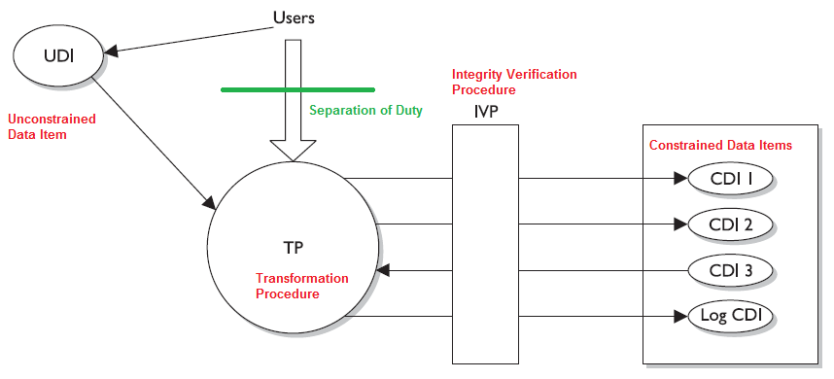
Clark-Wilson Model
Notes:
The Clark-Wilson Model
The Clark-Wilson model was developed after Biba and takes some different approaches to protecting the integrity of information. This model uses the following elements:
• Users Active agents
• Transformation procedures (TPs) Programmed abstract operations, such as read, write, and modify
• Constrained data items (CDIs) Can be manipulated only by TPs
• Unconstrained data items (UDIs) Can be manipulated by users via primitive read and write operations
• Integrity verification procedures (IVPs) Check the consistency of CDIs with external reality
Although this list may look overwhelming, it is really quite straightforward. When an application uses the Clark-Wilson model, it separates data into one subset that needs to be highly protected, which is referred to as a constrained data item (CDI), and another subset that does not require a high level of protection, which is called an unconstrained data item (UDI). Users cannot modify critical data (CDI) directly. Instead, the subject (user) must be authenticated to a piece of software, and the software procedures (TPs) will carry out the operations on behalf of the user. For example, when Kathy needs to update information held within her company’s database, she will not be allowed to do so without a piece of software controlling these activities. First, Kathy must authenticate to a program, which is acting as a front end for the database, and then the program will control what Kathy can and cannot do to the information in the database. This is referred to as access triple: subject (user), program (TP), and object (CDI). A user cannot modify CDI without using a TP.
So, Kathy is going to input data, which is supposed to overwrite some original data in the database. The software (TP) has to make sure this type of activity is secure and will carry out the write procedures for Kathy. Kathy (and any type of subject) is not trusted enough to manipulate objects directly.
The CDI must have its integrity protected by the TPs. The UDI does not require such a high level of protection. For example, if Kathy did her banking online, the data on her bank’s servers and databases would be split into UDI and CDI categories. The CDI category would contain her banking account information, which needs to be highly protected. The UDI data could be her customer profile, which she can update as needed. TPs would not be required when Kathy needed to update her UDI information.
In some cases, a system may need to change UDI data into CDI data. For example, when Kathy updates her customer profile via the web site to show her new correct address, this information will need to be moved into the banking software that is responsible for mailing out bank account information. The bank would not want Kathy to interact directly with that banking software, so a piece of software (TP) is responsible for copying that data and updating this customer’s mailing address. At this stage, the TP is changing the state of the UDI data to CDI.
A model is made up of constructs, mathematical formulas, and other PhD kinds of stuff. The model provides the framework that can be used to build a certain characteristic into software (confidentiality, integrity, and so on). So the model does not stipulate what integrity rules the IVP must enforce; it just provides the framework, and the vendor chooses the integrity rules. The vendor implements integrity rules that its customer base needs the most. So if a vendor is developing an application for a financial institution, the UDI could be customer profiles that they are allowed to update and the CDI could be the bank account information, usually held on a mainframe. The UDI data do not need to be as highly protected and can be located on the same system or another system. A user can have access to UDI data without the use of a TP, but when the user needs to access CDI, they must use TP. So the vendor who develops the product will determine what type of data is considered UDI and what type of data is CDI and develop the TPs to control and orchestrate how the software enforces the integrity of the CDI values.
In a banking application, the IVP would ensure that the CDI represents the correct value. For example, if Kathy has $2,000 in her account and then deposits $50, the CDI for her account should now have a value of $2,050. The IVP ensures the consistency of the data. So after Kathy carries out this transaction and the IVP validates the integrity of the CDI (new bank account value is correct), then the CDI is considered to be in a consistent state. TPs are the only components allowed to modify the state of the CDIs. In our example, TPs would be software procedures that carry out deposit, withdrawal, and transfer functionalities. Using TPs to modify CDIs is referred to as a well-formed transaction.
A well-formed transaction is a series of operations that are carried out to transfer the data from one consistent state to the other. If Kathy transfers money from her checking account to her savings account, this transaction is made up of two operations: subtract money from one account and add it to a different account. By making sure the new values in her checking and savings accounts are accurate and their integrity is intact, the IVP maintains internal and external consistency. The Clark-Wilson model also outlines how to incorporate separation of duties into the architecture of an application. If we follow our same example of banking software, if a customer needs to withdraw over $10,000, the application may require a supervisor to log in and authenticate this transaction. This is a countermeasure to potential fraudulent activities. The model provides the rules that the developers must follow to properly implement and enforce separation of duties through software procedures.
Internal and external consistency is provided by the IVP, which ensures that what is stored in the system as CDI properly maps to the input value that modified its state. So if Kathy has $2,500 in her account and she withdraws $2,000, the resulting value in the CDI is $500.
To summarize, the Clark-Wilson model enforces the three goals of integrity by using access triple (subject, software [TP], object), separation of duties, and auditing. This model enforces integrity by using well-formed transactions (through access triple) and separation of user duties.

Slide 34
Securing Data
Data backup
  Backup technologies
  Frequency of backup
Data masking
  Masking techniques
  Static vs dynamic
Secure data erasure
Notes:
Several topics of importance in today’s data security:
Data backup
Data masking
Data erasure

Slide 35
Data Backup
Why backup?
Backup vs archive
Backup technologies
  Local backup
  Server backup
  Enterprise backup
  Serverless backup (storage area network – SAN)
Notes:
From https://en.wikipedia.org/wiki/Backup
In information technology, a backup, or data backup is a copy of computer data taken and stored elsewhere so that it may be used to restore the original after a data loss event. The verb form, referring to the process of doing so, is "back up", whereas the noun and adjective form is "backup". Backups can be used to recover data after its loss from data deletion or corruption, or to recover data from an earlier time. Backups provide a simple form of disaster recovery; however not all backup systems are able to reconstitute a computer system or other complex configuration such as a computer cluster, active directory server, or database server.
Note the difference between backup and archiving: backup operations protect active data that's changing on a frequent basis whilst archiving operations produces a collection of historical records that are kept for long-term retention and used for future reference.
Data have become one of the most critical assets to nearly all organizations. These data may include financial spreadsheets, blueprints on new products, customer information, product inventory, trade secrets, and more.
Data usually changes more often than hardware and software, so these backup or archival procedures must happen on a continual basis. The data backup process must make sense and be reasonable and effective. If data in the files changes several times a day, backup procedures should happen a few times a day or nightly to ensure all the changes are captured and kept. If data is changed once a month, backing up data every night is a waste of time and resources. Backing up a file and its corresponding changes is usually more desirable than having multiple copies of that one file. Online backup technologies usually have the changes to a file made to a transaction log, which is separate from the original file.

Slide 36
Local Backup
Takes more media
Users may have to be relied to do their own backups
Less bandwidth taken
HDD, Tape, CD, DVD etc.

Slide 37
Server Backup
Back up data on a local or centralized server
The local file server stores most or all of the data of the enterprise
Data made available to clients via the LAN, using common IP network protocols (e.g. NFS, FTP, or CIFS)
Backup applications protect data on the local server by making copies of the data directly to the local backup system.
Cons
  Takes more bandwidth
  Users must copy data to server
  Limited data growth

Slide 38
Enterprise Backup
Enterprise-wide network clients automatically move backup data, via a network, to a backup drive connected to a backup server.
Automated libraries with multiple backup drives allow multiple backup streams to be received from multiple clients in parallel.
Backup clients are deployed on every system or workstation and send data on a schedule
Cons
  _{More bandwidth}
  _{More expensive}
  _{Still limited with data growth}

Slide 39
Server-less Backup
Data is moved via a separate backup network or fibre channel SAN directly from disk to tape
Only the main servers are connected to these fast and expensive networks
Workstations are connected via the TCP/IP network and data is written from the client directly to a tape drive via the relatively slow, but much cheaper, LAN.
A server must be involved in initiating and controlling the data moving over the SAN
Cons
  Very expensive
Notes:
See for example https://en.wikipedia.org/wiki/Storage_area_network for further information
A storage area network (SAN) or storage network is a computer network which provides access to consolidated, block-level data storage. SANs are primarily used to enhance accessibility of storage devices, such as disk arrays and tape libraries, to servers so that the devices appear to the operating system as locally-attached devices. A SAN typically is a dedicated network of storage devices not accessible through the local area network (LAN) by other devices, thereby preventing interference of LAN traffic in data transfer.
A SAN does not provide file abstraction, only block-level operations. However, file systems built on top of SANs do provide file-level access, and are known as shared-disk file systems.

Slide 40
Backup Types
Full backup
  Everything except swap files
  Not very efficient with media or time
  Usually performed weekly
Differential backup
  Only files modified since last full backup
  Archive bits must exist for each file and directory
Incremental backup
  All the files that have changed since the last full or incremental backup and sets the archive bit to 0
  Usually performed daily
  More efficient on network traffic, time and media
Notes:
The first step is to do a full backup, which is just what it sounds like—all data are backed up and saved to some type of storage media. During a full backup, the archive bit is cleared, which means that it is set to 0. A company can choose to do full backups only, in which case the restoration process is just one step, but the backup and restore processes could take a long time. Most companies choose to combine a full backup with a differential or incremental backup.
A differential process backs up the files that have been modified since the last full backup. When the data need to be restored, the full backup is laid down first, and then the most recent differential backup is put down on top of it. The differential process does not change the archive bit value.
An incremental process backs up all the files that have changed since the last full or incremental backup and sets the archive bit to 0. When the data need to be restored, the full backup data are laid down, and then each incremental backup is laid down on top of it in the proper order. If a company experienced a disaster and it used the incremental process, it would first need to restore the full backup on its hard drives and lay down every incremental backup that was carried out before the disaster took place (and after the last full backup). So, if the full backup was done six months ago and the operations department carried out an incremental backup each month, the restoration team would restore the full backup and start with the older incremental backups taken since the full backup and restore each one of them until they were all restored.
Note (From Wikipedia https://en.wikipedia.org/wiki/Archive_bit)
The archive bit is a file attribute used by Microsoft operating systems, OS/2, and AmigaOS. It is used to indicate whether or not the file has been backed up (archived). In Windows and OS/2, when a file is created or modified, the archive bit is set (i.e. turned on), and when the file has been backed up, the archive bit is cleared (i.e. turned off). Thus, the meaning of the archive bit is "this file has not been archived". An incremental backup task may use the archive bit to distinguish which files have already been backed up, and select only the new or modified files for backup.

Slide 41
What to back up?
Data files
Domain or tree databases
Domain controller registries
Don’t bother with
    program files?
    temp files
    non critical files
    seldom changed files

Slide 42
Rotation
Retention period
    how far back do you want to keep
Minimum rotation
    two media sets, rotate on each backup
Light Security rotation
    four media sets, labeled "Mon", "Wed", "Fri 1" and "Fri 2". Starting on the first Friday, a full backup is done to "Fri 1", and then it is stored off-site
Medium Security rotation
    daily backups with rotating sets
    weekly backups with rotating set

Slide 43
Offsite Storage and Vaulting
Electronic vaulting: backup via third party
It is regular and automatic
Specialised centers against computing and physical disaster
24x7 monitoring and user support
Issues:
  Who has access
  Speed
  Natural disaster protection
  Intrusion detection/security
  Encryption/transfer
  Guarantees
Notes:
Electronic vaulting and remote journaling are other solutions that companies should be aware of. Electronic vaulting makes copies of files as they are modified and periodically transmits them to an offsite backup site. The transmission does not happen in real time, but is carried out in batches. So, a company can choose to have all files that have been changed sent to the backup facility every hour, day, week, or month. The information can be stored in an offsite facility and retrieved from that facility in a short time. This form of backup takes place in many financial institutions, so when a bank teller accepts a deposit or withdrawal, the change to the customer’s account is made locally to that branch’s database and to the remote site that maintains the backup copies of all customer records.
Electronic vaulting is a method of transferring bulk information to offsite facilities for backup purposes. Remote journaling is another method of transmitting data offsite, but this usually only includes moving the journal or transaction logs to the offsite facility, not the actual files. These logs contain the deltas (changes) that have taken place to the individual files. If and when data are corrupted and need to be restored, the bank can retrieve these logs, which are used to rebuild the lost data. Journaling is efficient for database recovery, where only the reapplication of a series of changes to individual records is required to resynchronize the database.

Slide 44
Backup Issues
Size needed
Speed needed
Cost – (often cost per terabyte)
Automation
Software conflicts
Backup software compatibility with OS
Locked or open files
Tape life
Topology
Always perform data verification

Slide 45
Secure Data Erasure
Why
  Confidentiality issue
  Media flow in/out of organisation
Key
  Information classification
  Media types
Software based
Hardware based
Verifiable
Notes:
FROM NIST SP800-80 https://nvlpubs.nist.gov/nistpubs/Legacy/SP/nistspecialpublication800-88.pdf
Media sanitization is one key element in assuring confidentiality. In order for organizations to have appropriate controls on the information they are responsible for safeguarding, they must properly safeguard used media. An often rich source of illicit information collection is either through dumpster diving for improperly disposed hard copy media, acquisition of improperly sanitized electronic media, or through keyboard and laboratory reconstruction of media sanitized in a manner not commensurate with the confidentiality of its information. Media flows in and out of organizational control through recycle bins in paper form, out to vendors for equipment repairs, and hot swapped into other systems in response to emergencies. This potential vulnerability can be mitigated through proper understanding of where information is location, what that information is and how to protect it.
The key in deciding how to manage media in an organization is to first consider the information, then the media type. In organizations, information exists that is not associated with any categorized system. This information is often hard copy internal communications such as memoranda, white papers, and presentations. Sometimes this information may be considered sensitive. Examples may include internal disciplinary letters, financial or salary negotiations, or strategy meeting minutes. Organizations should label these media with their internal operating classifications and associate a type of sanitization described in this publication.

Slide 46
Secure Data Erasure
Categories
  Disposal: no consideration
  Clearing: against keyboard attack
  Purging: against laboratory attack
  Destroying: media cannot be reused
Notes:
FROM NIST SP800-80 https://nvlpubs.nist.gov/nistpubs/Legacy/SP/nistspecialpublication800-88.pdf
There are different types of sanitization for each type of media. We have divided media sanitization into four categories:
Disposal: discarding media with no other sanitization considerations
Clearing: a level of media sanitization that would protect the confidentiality of information against a robust keyboard attack, e.g. overwriting
Purging: a media sanitization process that protects the confidentiality of information against a laboratory attack, e.g. executing firmware secure erase command, degaussing hard drives
Destroying: destruction of media is the ultimate form of sanitization. After media are destroyed, they cannot be reused as originally intended. Physical destruction can be accomplished using a variety of methods, including disintegration, incineration, pulverizing, shredding, and melting.
Organizations should consider the following environmental factors. Note that the list is not all-inclusive:
What types (e.g., optical non-rewritable, magnetic) and size (e.g., megabyte, gigabyte, and terabyte) of media storage does the organization require to be sanitized?
What is the confidentiality of the data stored on the media?
Will the media be processed in a controlled area?
Should the sanitization process be conducted within the organization or outsourced?
What is the anticipated volume of media to be sanitized by type of media? 1
What is the availability of sanitization equipment and tools?
What is the level of training of personnel with sanitization equipment/tools?
How long will sanitization take?
What type of sanitization will cost more considering tools, training, validation, and re-entering media into the supply stream?

Slide 47
Data Masking
What
  Process of hiding original classified data
  Same format, different values
Where
  Testing applications/systems
  Training
  Third-party analytics
  Security requirements (invisible to operators)
Notes:
Process of hiding original data with random characters or data.
The main reason for applying masking to a data field is to protect data that is classified as personal identifiable data, personal sensitive data or commercially sensitive data, however the data must remain usable for the purposes of undertaking valid test cycles. It must also look real and appear consistent. It is more common to have masking applied to data that is represented outside of a corporate production system. In other words, where data is needed for the purpose of application development, building program extensions and conducting various test cycles. It is common practice in enterprise computing to take data from the production systems to fill the data component, required for these non-production environments. However the practice is not always restricted to non-production environments. In some organizations, data that appears on terminal screens to call centre operators may have masking dynamically applied based on user security permissions. (e.g.: Preventing call centre operators from viewing Credit Card Numbers in billing systems)
The primary concern from a corporate governance perspective is that personnel conducting work in these non-production environments are not always security cleared to operate with the information contained in the production data. This practice represents a security hole where data can be copied by unauthorised personnel and security measures associated with standard production level controls can be easily bypassed. This represents an access point for a data security breach.
The overall practice of Data Masking at an organisational level should be tightly coupled with the Test Management Practice and underlying Methodology and should incorporate processes for the distribution of masked test data subsets.
https://en.wikipedia.org/wiki/Data_masking

Slide 48
Data Masking
Requirements
  Must remain usable for testing purposes.
  Must look real and appear consistent.
  Not able to be reverse engineered.
  Must remain meaningful, e.g. credit card validation
  Must have sufficient changes to the original data
Notes:
Data involved in any data-masking or obfuscation must remain meaningful at several levels:
The data must remain meaningful for the application logic. For example, if elements of addresses are to be obfuscated and city and suburbs are replaced with substitute cities or suburbs, then, if within the application there is a feature that validates postcode or post code lookup, that function must still be allowed to operate without error and operate as expected. The same is also true for credit-card algorithm validation checks and Social Security Number validations.
The data must undergo enough changes so that it is not obvious that the masked data is from a source of production data. For example, it may be common knowledge in an organisation that there are 10 senior managers all earning in excess of $300K. If a test environment of the organisation's HR System also includes 10 identities in the same earning-bracket, then other information could be pieced together to reverse-engineer a real-life identity. Theoretically, if the data is obviously masked or obfuscated, then it would be reasonable for someone intending a data breach to assume that they could reverse engineer identity-data if they had some degree of knowledge of the identities in the production data-set. Accordingly, data obfuscation or masking of a data-set applies in such a manner as to ensure that identity and sensitive data records are protected - not just the individual data elements in discrete fields and tables.

Slide 49
Data Masking Techniques
Substitution
  Different authentic value is substituted for existing value
  Requires large substitution datasets
Notes:
Substitution is one of the most effective methods of applying data masking and being able to preserve the authentic look and feel of the data records. It allows the masking to be performed in such a manner that another authentic looking value can be substituted for the existing value. There are several data field types where this approach provides optimal benefit in disguising the overall data sub set as to whether or not it is a masked data set. For example, if dealing with source data which contains customer records, real life surname or first name can be randomly substituted from a supplied or customised look up file.
If the first pass of the substitution allows for applying a male first name to all first names, then the second pass would need to allow for applying a female first name to all first names where gender equals "F". Using this approach we could easily maintain the gender mix within the data structure, apply anonymity to the data records but also maintain a realistic looking database which could not easily be identified as a database consisting of masked data.
This substitution method needs to be applied for many of the fields that are in DB structures across the world, such as telephone numbers, zip codes and postcodes, as well as credit card numbers and other card type numbers like Social Security numbers and Medicare numbers where these numbers actually need to conform to a checksum test of the Luhn algorithm.
In most cases the substitution files will need to be fairly extensive so having large substitution datasets as well the ability to apply customised data substitution sets should be a key element of the evaluation criteria for any data masking solution.

Slide 50
Data Masking Techniques
Shuffling
  Randomly shuffled within the column
  Should not be used in isolation
Number and date variance
  +/- 10% can still be meaningful
  Date shifting
Masking out
  Similar to nulling out except keeping some of the data intact, e.g. XXXX XXXX XXXX 2345
  not effective for testing
Notes:
Shuffling
The shuffling method is a very common form of data obfuscation. It is similar to the substitution method but it derives the substitution set from the same column of data that is being masked. In very simple terms, the data is randomly shuffled within the column. However, if used in isolation, anyone with any knowledge of the original data can then apply a "What If" scenario to the data set and then piece back together a real identity. The shuffling method is also open to being reversed if the shuffling algorithm can be deciphered.
Shuffling however has some real strengths in certain areas. If for instance, the end of year figures for financial information in a test data base, one can mask the names of the suppliers and then shuffle the value of the accounts throughout the masked database. It is highly unlikely that anyone, even someone with intimate knowledge of the original data could derive a true data record back to its original values
Number and date variance
The numeric variance method is very useful for applying to financial and date driven information fields. Effectively, a method utilising this manner of masking can still leave a meaningful range in a financial data set such as payroll. If the variance applied is around +/- 10% then it is still a very meaningful data set in terms of the ranges of salaries that are paid to the recipients.
The same also applies to the date information. If the overall data set needs to retain demographic and actuarial data integrity then applying a random numeric variance of +/- 120 days to date fields would preserve the date distribution but still prevent traceability back to a known entity based on their known actual date or birth or a known date value of whatever record is being masked
Masking out
Character scrambling or masking out of certain fields is also another simplistic yet very effective method of preventing sensitive information to be viewed. It is really an extension of the previous method of nulling out but there is greater emphasis on keeping the data real and not fully masked all together.
This is commonly applied to credit card data in production systems. For instance, you may have spoken with an operator in a Call Centre and they have suggested they could bill an item to your credit card. They then quote you a billing reference to your card with the last 4 digits of XXXX XXXX xxxx 6789. As an operator they can only see the last 4 digits of your card number but once the billing system passes your details for charging the full number is revealed to the payment gateway systems.
This system is not very effective for test systems but is very useful for the billing scenario detailed above. It is also commonly known as a dynamic data masking method.

Slide 51
Data Masking Techniques
Encryption
  Most complex
  Requires key base on user rights
  Not effective
Nulling out / deletion
  Simplistic
  Cannot be used where software requires validation
Notes:
Encryption
Encryption is often the most complex approach to solving the data masking problem. The encryption algorithm often requires that a "key" be applied to view the data based on user rights. This often sounds like the best solution but in practice the key may then be given out to personnel without the proper rights to view the data and this then defeats the purpose of the masking exercise. Old databases may then be copied with the original credentials of the supplied key and the same uncontrolled problem lives on.
Recently, the problem of encrypting data while preserving the properties of the entities got a recognition and newly acquired interest among the vendors and academia. New challenge gave birth to algorithms called FPE ( format preserving encryption). They are based on the accepted AES algorithmic mode that makes them being recognized by NIST
Nulling out or deletion
Sometimes a very simplistic approach to masking is adopted through applying a null value to a particular field. The null value approach is really only useful to prevent visibility of the data element.
In almost all cases it lessens the degree of data integrity that is maintained in the masked data set. It is not a realistic value and will then fail any application logic validation that may have been applied in the front end software that is in the system under test. It also highlights to anyone that wishes to reverse engineer any of the identity data that data masking has been applied to some degree on the data set.

Slide 52
Types of Data Masking
Static
  Test data generated from backup of original data
Dynamic
  Masking happens at runtime, dynamically and on demand
  Avoid the need for a second data source to store masked data
On-The-Fly
  Copy from original to test environment
  Good for sharing data
  One record at a time
Notes:
Static Data Masking is done on the golden copy of the database. Production DBAs load the backup in a separate environment, reduce the data set to a subset that holds the data necessary for a particular round of testing (a technique called "subsetting"), apply data masking rules while data is in stasis, apply necessary code changes from source control and push data to desired environment.
On-the-Fly Data Masking happens in the process of transferring data from environment to environment without data touching the disk on its way. The same technique is applied to "Dynamic Data Masking" but one record at a time. This type of data masking is most useful for environments that do continuous deployments as well as for heavily integrated applications. Organizations that employ continuous deployment or continuous delivery practices do not have the time necessary to create a backup and load it to the golden copy of the database. Thus, continuously sending smaller subsets (deltas) of masked testing data from production is important. In heavily integrated applications, developers get feeds from other production systems at the very onset of development and masking of these feeds is either overlooked and not budgeted until later, making organizations non-compliant. Having on-the-fly data masking in place becomes essential.
Dynamic Data Masking is similar to On-the-Fly Data Masking but it differs in the sense that On-the-Fly Data Masking is about copying data from one source to another source so that the latter can be shared. Dynamic data masking happens at runtime, dynamically, and on-demand so that there need not be a second data source where to store the masked data dynamically.
Dynamic data masking enables several scenarios, many of which revolve around strict privacy regulations e.g. the Singapore Monetary Authority or the Privacy regulations in Europe.
Dynamic data masking is attribute-based and policy-driven. Policies include:
Doctors can view the medical records of patients they are assigned to (data filtering)
Doctors cannot view the SSN field inside a medical record (data masking).
Dynamic data masking can also be used to encrypt or decrypt values on the fly especially when using format-preserving encryption.

Slide 53
Static vs Dynamic
Advantages of static data masking
  Allows the development and testing without influencing live systems
  Best practice for working with contractors and outsourced developers, DBAs, and testing teams
  Provides a more in-depth policy of masking capabilities
  Allows organizations to share the database with external companies
Notes:
A very good article on the Internet to help understand more about the difference between static and dynamic masking
https://www.imperva.com/blog/static-versus-dynamic-data-masking/

Slide 54
Static vs Dynamic
Advantages of dynamic data masking
  The sensitive information never leaves the database!
  No changes are required at the application or the database layer
  Customized access per IP address, per user, or per application
  No duplicate or off-line database required
  Activities are performed on real data, saving time and providing real feedback to developers and quality assurance

Slide 55
Storage Devices
Storage devices are a fundamental component of a system and there many types devices available ranging from high capacity hard drives to small capacity USB drives or memory cards.
Storage devices are critical components from the point of view cyber security. Why?
Systems can booted from storage devices which can override local settings.
Notes:
Additional Storage Devices
Besides the memory environment discussed previously, many types of physical storage devices should be covered, along with the ramifications of security compromises that could affect them. Many, if not all, of the various storage devices used today enable the theft or compromise of data in an organization. As their sizes have shrunk, their capacities have grown. Floppy disks, while small in relative storage capacity (about 1.44MB of data), have long been known to be a source of viruses and data theft. A thief who has physical access to a computer with an insecure operating system can use a basic floppy disk to boot the system.
Many PCs and Unix workstations have a BIOS that allows the machine to be booted from devices other than the floppy disk, such as a CD-ROM or even a USB thumb drive. Possible ways to harden the environment include password-protecting the BIOS so that a nonapproved medium cannot take over the machine, and controlling access to the physical environment of the computer equipment.
In many instances, removable storage units have unfortunately come up missing. Two noteworthy incidents occurred in July 2004, at which time both Los Alamos National Laboratory and Sandia National Laboratories reported lost storage media containing classified information. This raised enough of a concern at Los Alamos that the military research facility was totally shut down, with no employees allowed to enter, while a thorough search and investigation was performed. Sandia National Laboratories reported it was missing a computer floppy disk marked classified, which it later located.
Rewritable CD/DVDs, mini-disks, optical disks—virtually any portable storage medium—can be used to compromise security. Current technology headaches for the security professional include USB thumb drives and USB-attachable MP3 players capable of storing multiple gigabytes of data. The first step in prevention is to update existing security policies (or implement new ones) to include the new technologies. Even cellular phones can be connected to computer ports for data, sound, image, and video transmission that could be out of bounds of an outdated security policy. Technologies such as Bluetooth, FireWire, and Blackberry all have to be taken into account when addressing security concerns and vulnerabilities.

Slide 56
Storage Devices
Confidential information can be retrieved by gaining access to the storage devices (which are either discarded without being properly "wiped" or removed from the systems).
Confidential information can illegally copied via removable media.

Slide 57
Storage Devices
Virtual memory - used to extend the system memory.
The access to the virtual memory is slower because of the nature of the storage.
Problems with virtual memory:
  a) access to encrypted data
  b) access to memory contents after the power has been turned off.
Notes:
Virtual Memory
Secondary storage is considered nonvolatile storage media and includes such things as the computer’s hard drive, floppy disks, and CD-ROMs. When RAM and secondary storage are combined, the result is virtual memory. The system uses hard drive space to extend its RAM memory space. Swap space is the reserved hard drive space used to extend RAM capabilities. Windows systems use the pagefile.sys file to reserve this space. When a system fills up its volatile memory space, it writes data from memory onto the hard drive. When a program requests access to this data, it is brought from the hard drive back into memory in specific units, called pages. This process is called virtual memory paging. Accessing data kept in pages on the hard drive takes more time than accessing data kept in memory because physical disk read/write access must take place. Internal control blocks, maintained by the operating system, keep track of what page frames are residing in RAM and what is available “offline,” ready to be called into RAM for execution or processing, if needed. The payoff is that it seems as though the system can hold an incredible amount of information and program instructions in memory.
Paging, pageframes, etc
A security issue with using virtual swap space is that when the system is shut down, or processes that were using the swap space are terminated, the pointers to the pages are reset to “available” even though the actual data written to disk is still physically there. These data could conceivably be compromised and captured. On a very secure operating system, there are routines to wipe the swap spaces after a process is done with it, before it is used again. The routines should also erase this data before a system shut- down, at which time the operating system would no longer be able to maintain any control over what happens on the hard drive surface.
NOTE - If a program, file, or data are encrypted and saved on the hard drive, they will be decrypted when used by the controlling program. While these unencrypted data are sitting in RAM, the system could write out the data to the swap space on the hard drive, in their unencrypted state. Attackers have figured out how to gain access to this space in unauthorized manners.

Slide 58
Virtual Machines
Virtual machines - enables the running of multiple OSes on the same system.
Current virtualization software is advanced:
  a) it allows very effective simulations of OSes - depending on the level of access and hardware support, the virtual machine can indistinguishable from the actual machine,
  b) it can be used to simulate large scale systems rather than individual machines - e.g. VMWare allows the user to tailor specific networks of virtual servers and user machines.
Virtualization is key aspect of cloud computing and poses major challenges in terms of cyber security.
Notes:
Virtual Machines
If you have been into computers for a while, you might remember computer games that did not have the complex, life-like graphics of today’s games. Pong and Asteroids were what we had to play with when we were younger. In those simpler times, the games were 16-bit and were written to work in a 16-bit MS-DOS environment. When our Windows operating systems moved from 16-bit to 32-bit, the 32-bit operating systems were written to be backward compatible, so someone could still load and play a 16-bit game in an environment that the game did not understand. The continuation of this little life pleasure was available to users because the operating systems created virtual machines for the games to run in.
When a 16-bit application needs to interact with the operating system, it has been developed to make system calls and interact with the computer’s memory in a way that would only work within a 16-bit operating system—not a 32-bit system. So, the virtual machine simulates a 16-bit operating system, and when the application makes a request, the operating system converts the 16-bit request into a 32-bit request (this is called thunking) and reacts to the request appropriately. When the system sends a reply to this request, it changes the 32-bit reply into a 16-bit reply so the application understands it.
Today, virtual machines are much more advanced. Basic virtualization enables single hardware equipment to run multiple operating system environments synchronously, greatly enhancing processing power utilization, among other benefits. Creating virtual instances of operating systems, applications, and storage devices is known as virtualization.
In today’s jargon, a virtual instance of an operating system is known as a virtual machine. A virtual machine is commonly referred to as a guest that is executed in the host environment. Virtualization allows a single host environment to execute multiple guests at once, with multiple virtual machines dynamically pooling resources from a common physical system. Computer resources such as RAM, processors, and storage are emulated through the host environment. The virtual machines do not directly access these resources; instead, they communicate with the host environment responsible for managing system resources.
What this means is that you can have one computer running several different operating systems at one time. For example, you can run a system with Windows 2000, Linux, Unix, and Windows 2008 on one computer. Think of a house that has different rooms. Each operating system gets its own room, but each share the same resources that the house provides—a foundation, electricity, water, roof, and so on. An operating system that is “living” in a specific room does not need to know about or interact with another operating system in another room to take advantage of the resources provided by the house. The same concept happens in a computer: Each operating system shares the resources provided by the physical system (as in memory, processor, buses, and so on). They “live” and work in their own “rooms,” which are the guest virtual machines. The physical computer itself is the host.

Slide 59
Virtualization and Cloud Computing
What is cloud computing?
  A model which enables the combination of hardware, software, networking that allows the delivery of on-demand computing resources via the Internet or private network.
What are the categories of cloud solutions?
  Public cloud
  Community cloud
  Private cloud
  Hybrid cloud
Notes:
What is cloud computing?
An IT model or computing environment composed of IT components (hardware, software, networking, and services) as well as the processes around the deployment of these elements that together enable us to develop and deliver cloud services via the Internet or a private network.
Public cloud. The cloud infrastructure is made available to the general public or a large industry group and is owned by an organization selling cloud services. In its simplest definition, a public cloud exists externally to its end user and is generally available with little restriction as to who may pay to use it. As a result, the most common forms of public clouds are ones that are accessed via the Internet. There has been tremendous development in the public cloud space, resulting in very sophisticated Infrastructure-as-a-Service offerings from companies like Amazon, with their Elastic Compute Cloud (EC2), Rackspace’s Cloud Offerings, and IBM’s BlueCloud. Other forms of public cloud offerings can take the form at more of the application layer, or Platform-as-a-Service, like Google’s AppEngine and Windows’ Azure Services platform, as well as Amazon’s service-specific cloud hosting SimpleDB, Cloud Front, and S3 Simple Storage.
At a basic level, public clouds have unique security components and evaluation criteria when compared with private clouds. Public clouds can be formed by service providers wishing to build out a high-capacity infrastructure and lease pieces of it to a variety of clients. As a result, data might become comingled on common storage devices, making identity, access control, and encryption very important. There is a certain amount of inherent trust (albeit it should be a measured, tested, and verified) by subscribers with their public cloud providers.
Community cloud. The cloud infrastructure is shared by several organizations and supports a specific community that has shared concerns (e.g., mission, security requirements, policy, and compliance considerations). It may be managed by the organizations or a third party and may exist on premise or off premise. The promise of community clouds is that they allow multiple independent entities to gain the cost benefits of a shared nonpublic cloud while avoiding security and regulatory concerns that might be associated with using a generic public cloud that did not address such concerns in its SLA. This model has tremendous potential for entities or companies that are subject to identical regulatory, compliance, or legal restrictions. Different kinds of community clouds are being considered in the United States and the European Union by governments at the national and local levels. This makes great sense since there are multiple benefits to both the individual entities as well as collectively. For instance, when multiple government agencies that transact business with each other have their processing colocated in a single facility, they can achieve both savings and increased security in terms of reducing the amount of traffic that would otherwise need to traverse the Internet. Continuity of operations can also be enhanced at a lower overall cost to all parties when multiple data centers are used to implement such a community cloud.
Private cloud. The cloud infrastructure is operated solely for an organization. It may be managed by the organization or a third party and may exist on premise or off premise. In contrast to a public cloud, a private cloud is internally hosted. The hallmark of a private cloud is that it is usually dedicated to an organization. Although there is no comingling of data or sharing of resources with external entities, different departments within the organization may have strong requirements to maintain data isolation within their shared private cloud. Organizations deploying private clouds often do so utilizing virtualization technology within their own data centers. A word of caution here:
“Describing private cloud as releasing you from the constraints of public cloud only does damage to the cloud model. It’s the discipline in cloud implementations that makes them more interesting (and less costly) than conventional IT. Private clouds could very well be more constrained than their public counterparts and probably will be to meet those needs that public clouds cannot address.”
Since private clouds are, well, private, some of the security concerns of a public cloud may not apply. However, just because they are private does not mean that they are necessarily more secure. In a private cloud, considerations such as securing the virtualization environment itself (that is, hypervisor level security, physical hardware, software, and firmware, and so on) must still be addressed, whereas in a public cloud, you would rely on the provider to do so. As a result, when comparing public to private clouds, it may be difficult to make generalizations as to which is inherently more secure. But as we pointed out earlier in this chapter in the section on Control over Security in the Cloud Model, a private cloud offers the potential to achieve greater security over your cloud-based assets. However, between the potential for better security and the achievement of better security lie many ongoing activities. The true advantage of a private cloud is that “the provider has a vested interest in making the service interface more perfectly matched to the tenant needs.” However, it should also be pointed out that many of the sins of enterprise security have to do with the fact that the enterprise itself implements and manages its own IT security—which would be perfectly fine except security is generally not a core investment nor is it measured as though it were.
Hybrid cloud. The cloud infrastructure is a composition of two or more clouds (private, community, or public) that remain unique entities but are bound together by standardized or proprietary technology that enables data and application portability (e.g., cloud bursting for load-balancing between clouds). Hybrid clouds are just as the name implies. They are formed when an organization builds out a private cloud and wishes to leverage public or community clouds in conjunction with its private cloud for a particular purpose; the linking of the two clouds is what would be called a hybrid cloud. (Actually, a hybrid cloud could be formed by any combination of the three cloud types: public, private, and community.)
Many organizations deploy an internal private cloud for their critical infrastructure but find certain needs that just aren’t economical to build out internally. A common example would be for testing or quality assurance purposes. For instance, an internal cloud might be used to run the infrastructure of a business, but the business may need to test an upgrade or roll out of a new system. It might be advantageous to pay for capacity of a public cloud for a few months to complete the testing, and when their own private cloud is upgraded, discontinue the public cloud usage.
Another example of a hybrid cloud would be a Web site where its core infrastructure is private to the company, but certain components of the Web site are hosted externally—that is, heavily trafficked media such as streaming video or image caching.
If an organization has already built out an internal cloud, additional advantages of public cloud–based architectures may be too great to ignore. As a result, many organizations may consider the benefits of adopting a public–private hybrid model. However, certain requirements can prevent hybrid clouds from being fully adopted by an organization. For instance, financial services organizations might not be able to meet specific compliance regulations if customer data is externally hosted at a third party, no matter how well it may be secured. Governments might not be able to take the risk of the compromise (political, malicious, or otherwise) if their cloud-based data is attacked. Yet all these organizations might still have specific use cases for public clouds.

Slide 60
Virtualization and Cloud Computing
Why use the cloud?
  on-demand storage and processing resources at typically lower cost
  dedicated security comes as part of the typical cloud solution
Cloud services
  Infrastructure-as-a-Service (IaaS): e.g. Amazon AWS, Microsoft Azure
  Platform-as-a-Service (PaaS): e.g. Google Cloud Platform, Microsoft ML studio
  Software-as-a-Service (SaaS): e.g. GoogleDoc, Gmail, Office365
Notes:
Cloud Platform-as-a-Service
PaaS providers usually deliver a bundling of software and infrastructure in the form of a programmable container and provide a cloud for an end user to host their own developed applications or services. PaaS is similar to SaaS, but with PaaS, the service is the entire application environment—typically, PaaS includes the computing platform as well as the development and solution stack.
Google’s Google App Engine is an excellent example of a PaaS architecture. So is Salesforce.com’s Force.com platform. In both cases, the end user receives an environment from the provider (also called a container) that is ready to host a particular application or service that the end user requires. The end user does not need to worry about lower-level services such as the infrastructure; these are provided for them within the service.
Cloud Infrastructure-as-a-Service
In general, IaaS clouds deliver virtualized resources, such as guest virtual machines (ready to load an operating system), storage, or database services. The tenant interacts with IaaS clouds in a similar way as giving a systems architecture to an IT department to provide the necessary systems (although usually with very formal descriptions). This is the virtual equivalent to physically deploying servers, storage, or database.
Amazon’s Web Services or RackSpace’s Cloud Services are both prime examples of IaaS providers. In their most common form, end users choose to still have the ability to manage their infrastructure at the operating system level but out- source as-a-service the details of managing and maintaining the servers, switching, routing, firewalling, and connectivity concerns. They basically purchase this bundled from the IaaS provider.
Cloud Software-as-a-Service
In its most common form, a SaaS cloud implementation delivers software or, more generally described, an application to its end user. The end user doesn’t usually need to understand or be concerned with the supporting infrastructure and simply utilizes an application. All the back office details of the application are masked and provided as-a-service behind the scenes of that application.
Web sites accessed via the Internet that provide the end user an application or a service can be considered SaaS. For instance, Salesforce.com provides a CRM SaaS, Google’s GMAIL or Yahoo Mail provide email services, and even former premise- based software-only solutions like Microsoft Share Point are available as SaaS online, via a Web browser.
There are several important security concerns we need to address in considering the use of virtualization for cloud computing. One potential new risk area has to do with the potential to compromise a virtual machine hypervisor itself. If the hypervisor is vulnerable to being exploited, it will become a primary target. At the scale of a cloud, such a risk would have broad impact if not otherwise mitigated with network isolation and if it is not detected by security monitoring.
What is a hypervisor?
hypervisors are purpose-build software with a small and specific set of functions. A hypervisor is smaller, more focused than a general purpose operating system, and less exposed, having fewer or no externally accessible network ports. A hypervisor does not undergo frequent change and does not run third-party applications. The guest operating systems, which may be vulnerable, do not have direct access to the hypervisor. In fact, the hypervisor is completely transparent (invisible) to network traffic with the exception of traffic to/from a dedicated hypervisor management interface. Furthermore, at present there are no documented attacks against hypervisors, reducing the likelihood of attack.
Network Availability The value of cloud computing can only be realized when your network connectivity and bandwidth meet your minimum needs: The cloud must be available whenever you need it. If it is not, then the consequences are no different than a denial-of-service situation.
Cloud Provider Viability Since cloud providers are relatively new to the business, there are questions about provider viability and commitment. This concern deepens when a provider requires tenants to use proprietary interfaces, thus leading to tenant lock-in.
Disaster Recovery and Business Continuity Tenants and users require confidence that their operations and services will continue if the cloud provider’s production environment is subject to a disaster.
Security Incidents Tenants and users need to be appropriately informed by the provider when an incident occurs. Tenants or users may require provider support to respond to audit or assessment findings. Also, a provider may not offer sufficient support to tenants or users for resolving investigations.
Transparency When a cloud provider does not expose details of their internal policy or technology implementation, tenants or users must trust the cloud provider’s security claims. Even so, tenants and users require some transparency by providers as to provider cloud security, privacy, and how incidents are managed.
Loss of Physical Control Since tenants and users lose physical control over their data and applications, this results in a range of concerns:
Privacy and Data With public or community clouds, data may not remain in the same system, raising multiple legal concerns.
Control over Data User or organization data may be comingled in various ways with data belonging to others.
A tenant administrator has limited control scope and accountability within a Public infrastructure-as-a-service (IaaS) implementation, and even less with a platform-as-a-service (PaaS) one. Tenants need confidence that the provider will offer appropriate control, while recognizing that tenants will simply need to adapt their expectations for how much control is reasonable within these models.
New Risks, New Vulnerabilities There is some concern that cloud computing brings new classes of risks and vulnerabilities. Although we can postulate various hypothetical new risks, actual exploits will largely be a function of a provider’s implementation. Although all software, hardware, and networking equipment are subject to unearthing of new vulnerabilities, by applying layered security and well-conceived operational processes, a cloud may be protected from common types of attack even if some of its components are inherently vulnerable.

Slide 61
Cloud Computing Issues
Virtualization issues, e.g. hypervisors
Network availability
Cloud provider viability
Security incidents
Transparency
Notes:
There are security issues with Cloud Computing, below are some common issues:
Compromised Hypervisors:
There are several important security concerns we need to address in considering the use of virtualization for cloud computing. One potential new risk area has to do with the potential to compromise a virtual machine hypervisor itself. If the hypervisor is vulnerable to being exploited, it will become a primary target. At the scale of a cloud, such a risk would have broad impact if not otherwise mitigated with network isolation and if it is not detected by security monitoring.
What is a hypervisor? hypervisors are purpose-build software with a small and specific set of functions. A hypervisor is smaller, more focused than a general purpose operating system, and less exposed, having fewer or no externally accessible network ports. A hypervisor does not undergo frequent change and does not run third-party applications. The guest operating systems, which may be vulnerable, do not have direct access to the hypervisor. In fact, the hypervisor is completely transparent (invisible) to network traffic with the exception of traffic to/from a dedicated hypervisor management interface. Furthermore, at present there are no documented attacks against hypervisors, reducing the likelihood of attack.
Network Availability The value of cloud computing can only be realized when your network connectivity and bandwidth meet your minimum needs: The cloud must be available whenever you need it. If it is not, then the consequences are no different than a denial-of-service situation.
Cloud Provider Viability Since cloud providers are relatively new to the business, there are questions about provider viability and commitment. This concern deepens when a provider requires tenants to use proprietary interfaces, thus leading to tenant lock-in.
Disaster Recovery and Business Continuity Tenants and users require confidence that their operations and services will continue if the cloud provider’s production environment is subject to a disaster.
Security Incidents Tenants and users need to be appropriately informed by the provider when an incident occurs. Tenants or users may require provider support to respond to audit or assessment findings. Also, a provider may not offer sufficient support to tenants or users for resolving investigations.
Transparency When a cloud provider does not expose details of their internal policy or technology implementation, tenants or users must trust the cloud provider’s security claims. Even so, tenants and users require some transparency by providers as to provider cloud security, privacy, and how incidents are managed.

Slide 62
Cloud Computing Issues
Cross VM traffic
Cloud data storage
Loss of physical control
New risks new vulnerabilities
Notes:
Cross VM traffic
A further area of concern with virtualization has to do with the potential for undetected network attacks between VMs that are colocated on a physical server. The problem is that unless the traffic from each VM can be monitored, you cannot verify that traffic is not possible between VMs. There are several possible approaches here, the first is that the VM user can simply invoke OS-based traffic filtering or firewalling. One potential complication that can be faced by a customer who needs multiple communicating and cooperating VMs is that these VMs may be dynamically moved around by the service provider to load balance their cloud. If VM Internet Protocol (IP) addresses change during this relocation (unlikely, but possible between VM instantiations) and absolute addressing is used for firewall rules, then firewall filtering will fail.
Although a tenant or customer may have on-demand access to security controls such as virtual firewalls, authentication services, and security logging, these services may undergo change as the underlying implementation is patched or updated. Firewall rules and other security configuration data may become operationally incorrect as VM images are re-provisioned in an updated or reconfigured infrastructure. Although this is typically handled by public cloud implementations, there is a need for fundamental improvement in areas such as version control and configuration management for cloud implementations.
There are other risks, including unintended interactions or information transfer when on-demand security controls are integrated with a customer application. Recycled user IDs and IP addresses also represent concern if recycling an IP or UID makes it possible for a user to inadvertently gain access to an information resource that is not theirs. The essential issue here has to do with the correctness and completeness of the process that implements allocation and deallocation of any VMs, information resources or enabling elements.
Cloud Data Storage
There are several concerns around cloud data storage, and these include the following:
1) Since clouds tend to implement storage as centralized facilities, some view storage as having the potential to be an attractive target for criminals or hackers. This has always been the case for any valuable resource and can be mitigated by the application of appropriate security controls.
2) Multitenancy again presents concerns, this time with the potential for data isolation mechanisms that may either fail in operation or in a rollback operation from a backup system.
3) Storage systems are complex hardware and software implementations. There are always questions as to the potential for catastrophic failure modes that might either destroy the data or expose the data from one customer to another customer.
Loss of Physical Control Since tenants and users lose physical control over their data and applications, this results in a range of concerns:
Privacy and Data With public or community clouds, data may not remain in the same system, raising multiple legal concerns.
Control over Data User or organization data may be comingled in various ways with data belonging to others.
A tenant administrator has limited control scope and accountability within a Public infrastructure-as-a-service (IaaS) implementation, and even less with a platform-as-a-service (PaaS) one. Tenants need confidence that the provider will offer appropriate control, while recognizing that tenants will simply need to adapt their expectations for how much control is reasonable within these models.
New Risks, New Vulnerabilities There is some concern that cloud computing brings new classes of risks and vulnerabilities. Although we can postulate various hypothetical new risks, actual exploits will largely be a function of a provider’s implementation. Although all software, hardware, and networking equipment are subject to unearthing of new vulnerabilities, by applying layered security and well-conceived operational processes, a cloud may be protected from common types of attack even if some of its components are inherently vulnerable.

Slide 63
Common Attacks
Ransomware attacks
Denial of service/Distributed denial of service (DoS/DDoS) attacks
Data exfiltration
SQL Injection attacks
Cross site scripting (XSS) attacks
Phishing attacks
Virus/malware
Notes:
We look at common attacks to data and systems nowadays

Slide 64
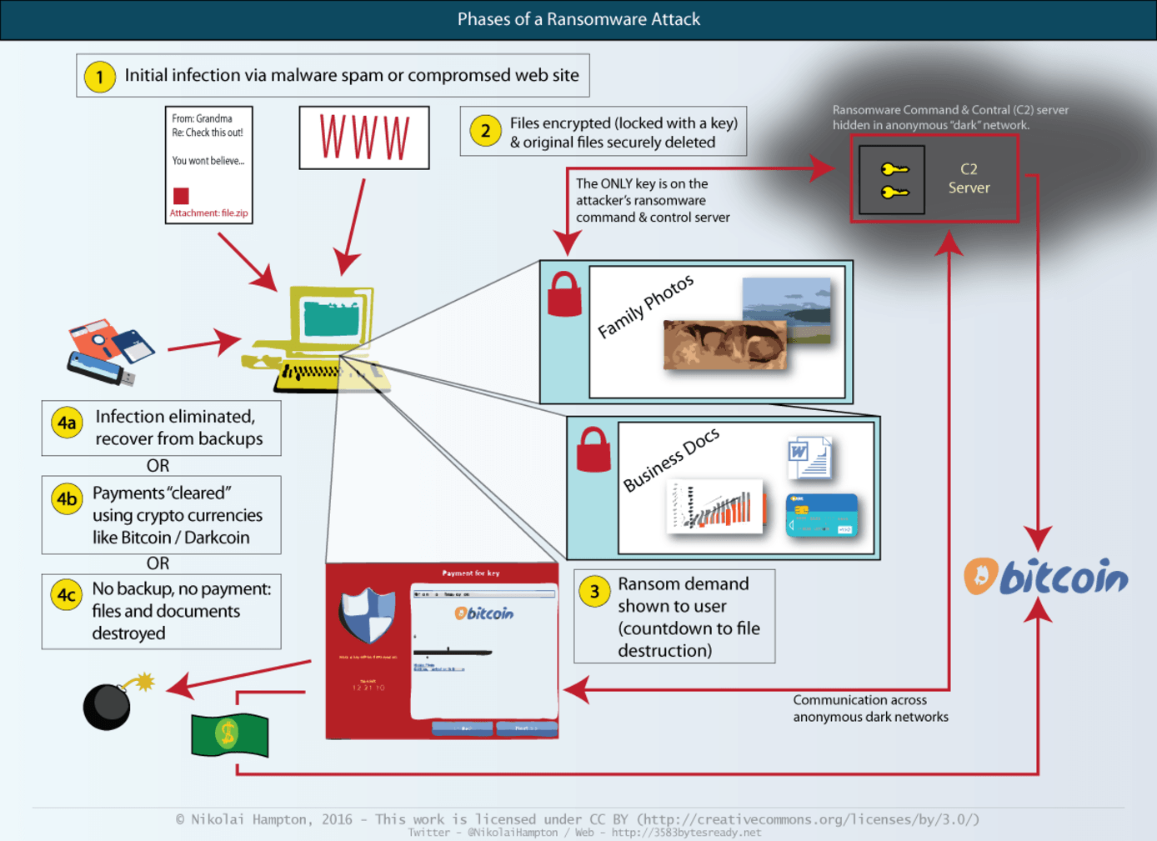
Ransomware Attacks
https://www.weforum.org/agenda/2017/05/ransomware-what-is-it-how-does-it-work-and-can-you-protect-yourself
Notes:
Students are encouraged to do further reading from relevant articles, for example
https://en.wikipedia.org/wiki/Ransomware

Slide 65
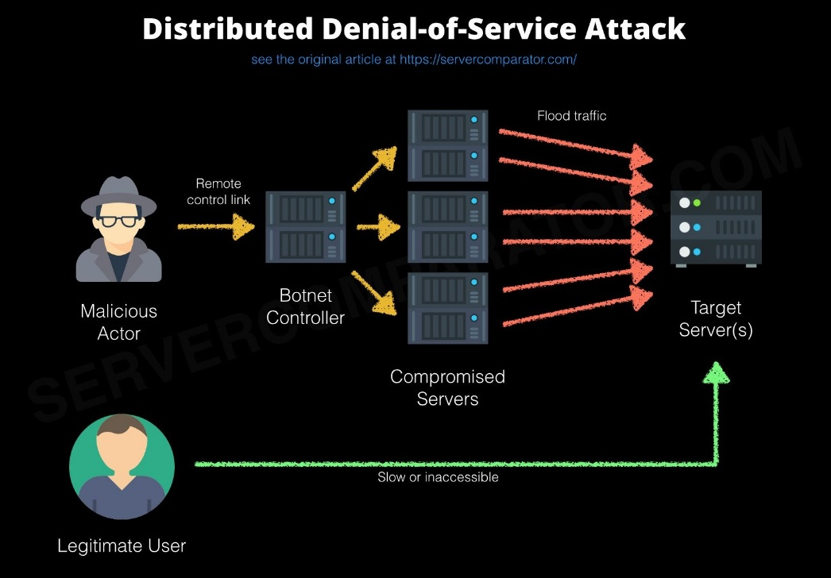
Distributed Denial of service
https://blogs.msdn.microsoft.com/mlserver/2017/07/11/understanding-server-traffic-logs-and-detecting-denial-of-service-attacks/
Notes:
Reading https://www.cloudflare.com/en-au/learning/ddos/what-is-a-ddos-attack/

Slide 66
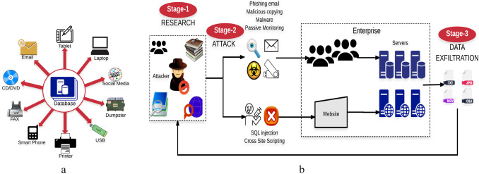
Data Exfiltration
a.k.a. advanced persistent threat (APT)
https://www.sciencedirect.com/science/article/pii/S1084804517303569
Notes:
Some useful references
https://resources.infosecinstitute.com/anatomy-of-an-apt-attack-step-by-step-approach/#gref
https://azeria-labs.com/data-exfiltration/

Slide 67
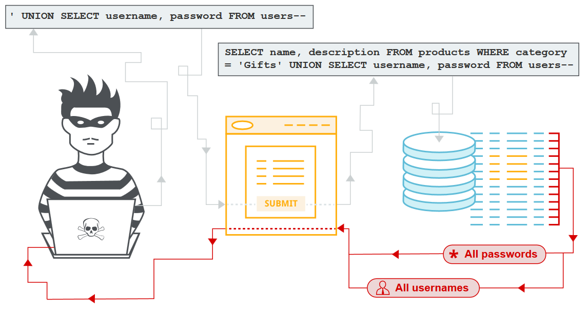
SQL Injection
https://portswigger.net/web-security/sql-injection
Notes:
Reading
https://en.wikipedia.org/wiki/SQL_injection
https://portswigger.net/web-security/sql-injection

Slide 68
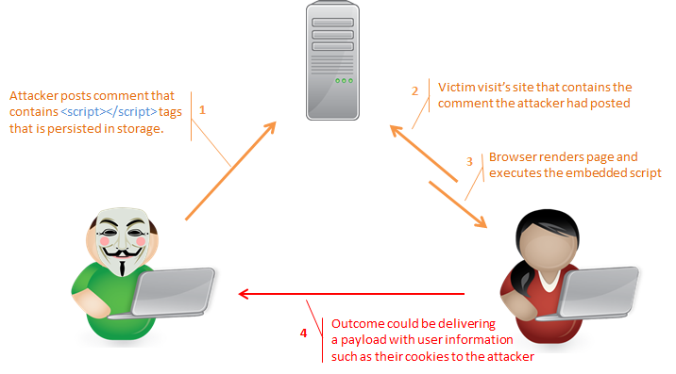
Cross-site Scripting (XSS)
https://blog.sucuri.net/2016/04/what-is-an-xss-vulnerability.html

Slide 69
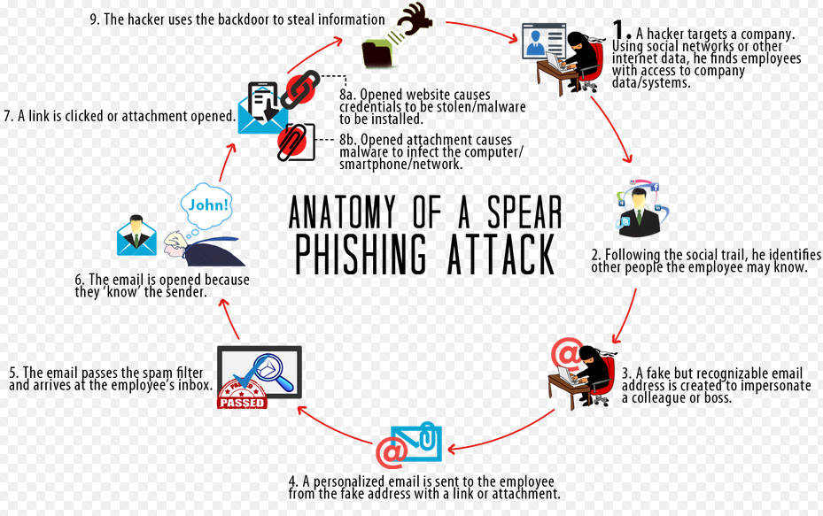
Phishing
https://madhatmedia.com.au/linkedin-spear-phishing-attacks/
Notes:
Reading
https://en.wikipedia.org/wiki/Phishing
https://www.imperva.com/learn/application-security/phishing-attack-scam/

Slide 70
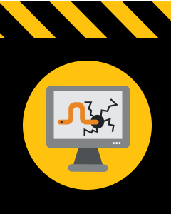
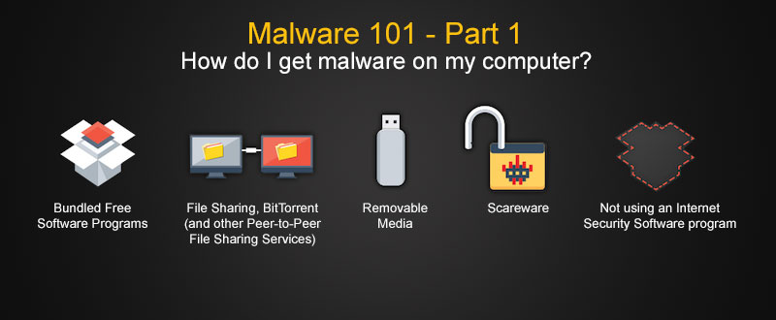
Virus/malware
https://uk.norton.com/internetsecurity-malware.html
Notes:
Reading
https://us.norton.com/internetsecurity-malware-what-is-a-computer-virus.html

Slide 71
Need to Know
Generally how attacks happen
What issue: Availability, Integrity, or Confidentiality?
How to address the threat?
  Prevention
  Detection
  Correction
  Recovery

